Slide 1
Cloud and Aerosol size distributions and CCN activity
Sara Lance
WFM Pilot Study, Preliminary Observations
Aug 24, 2017

Slide 2
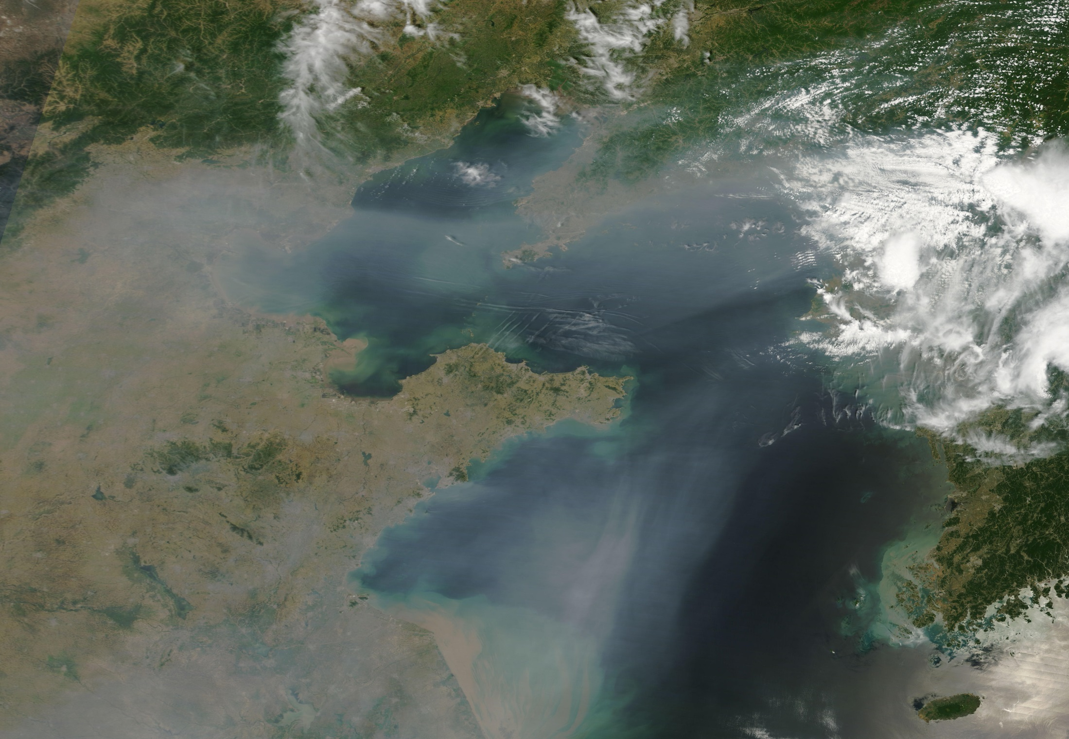
Aerosol Impacts: Climate (‘Global Dimming’)
Haze blown off the Eastern coast of China, over Bo Hai Bay and the Yellow Sea

Slide 3
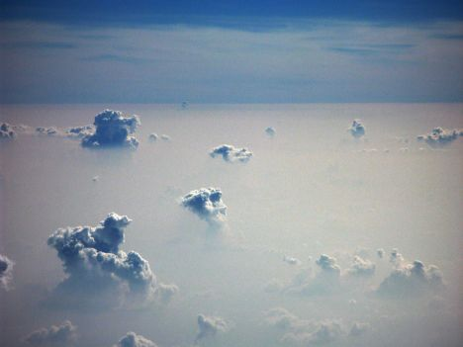
Aerosol Impacts: Climate (Effects on Clouds)
“Indirect Effect” of Aerosols on Climate
More particles that act as “Cloud Condensation Nuclei” = clouds with a higher concentration of droplets

Slide 4
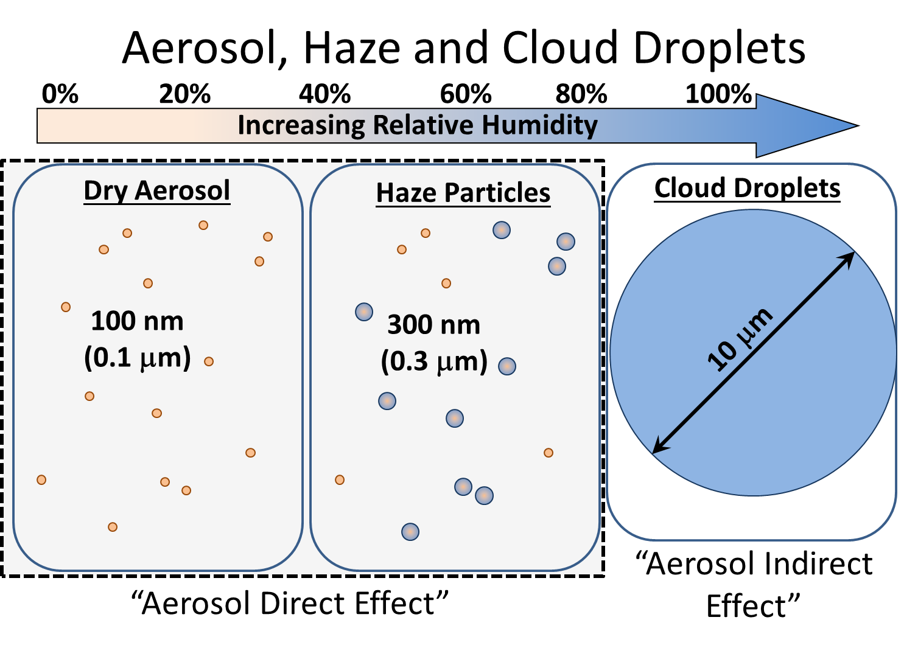
Notes:
Continuum between the aerosol and cloud measurements, since particles do not remain a constant size. Dry aerosol particles grow hygroscopically when exposed to water vapor. At RH < 100% some particles can swell significantly and become haze particles. Above 100% RH, the hygroscopic particles can then ‘activate’ and act as CCN, at which point they grow very quickly through condensation to become cloud droplets, which are typically 10-20 um in diameter.

Slide 5
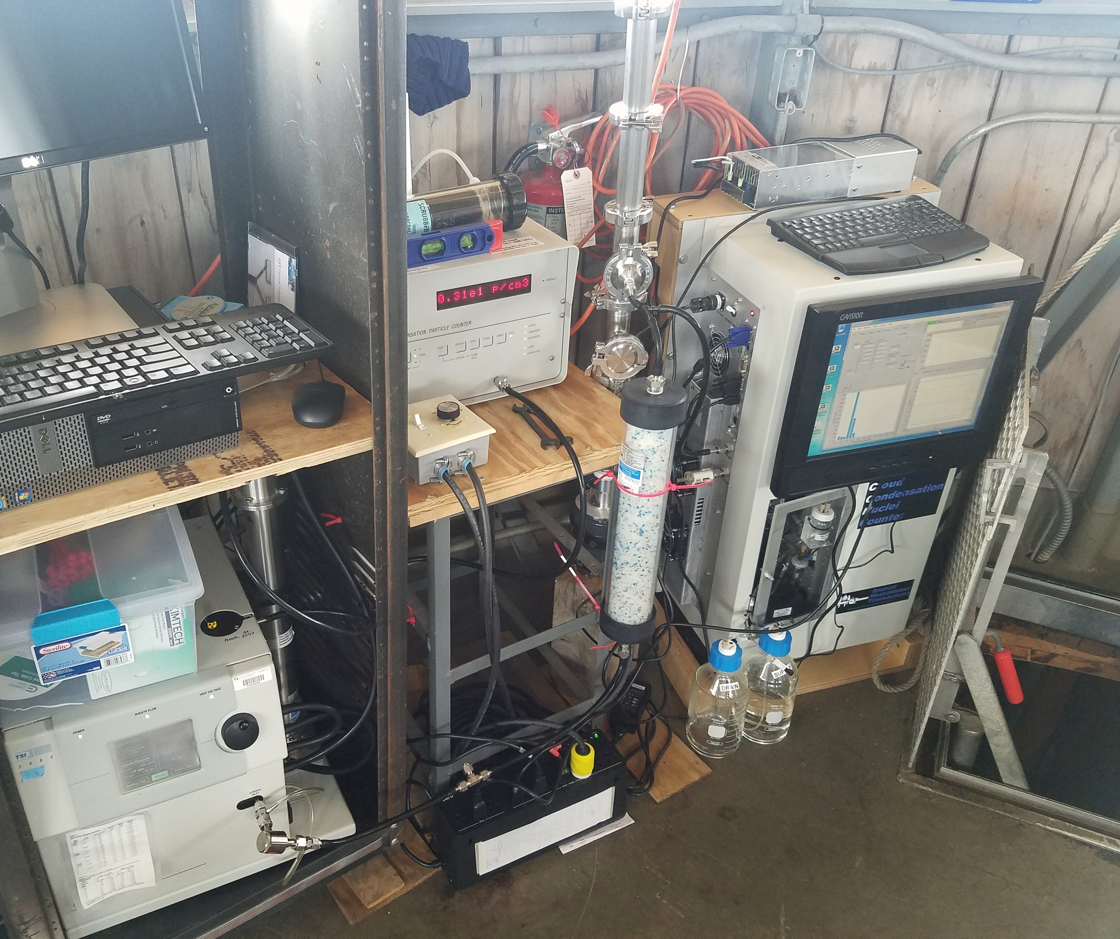
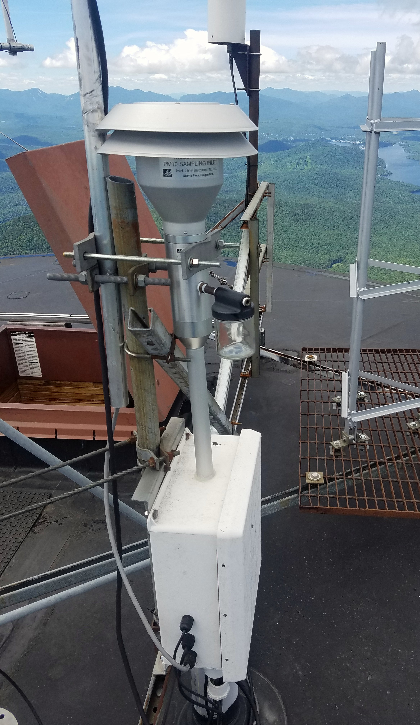
Aerosol Instruments installed at the WFM summit
Installed June 22, 2017

Slide 6
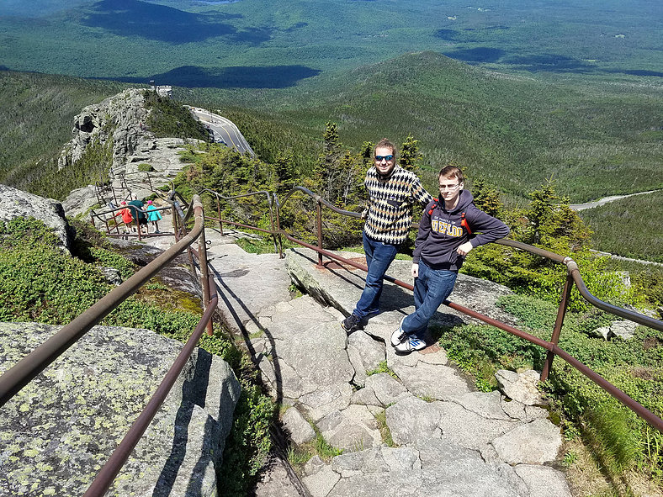
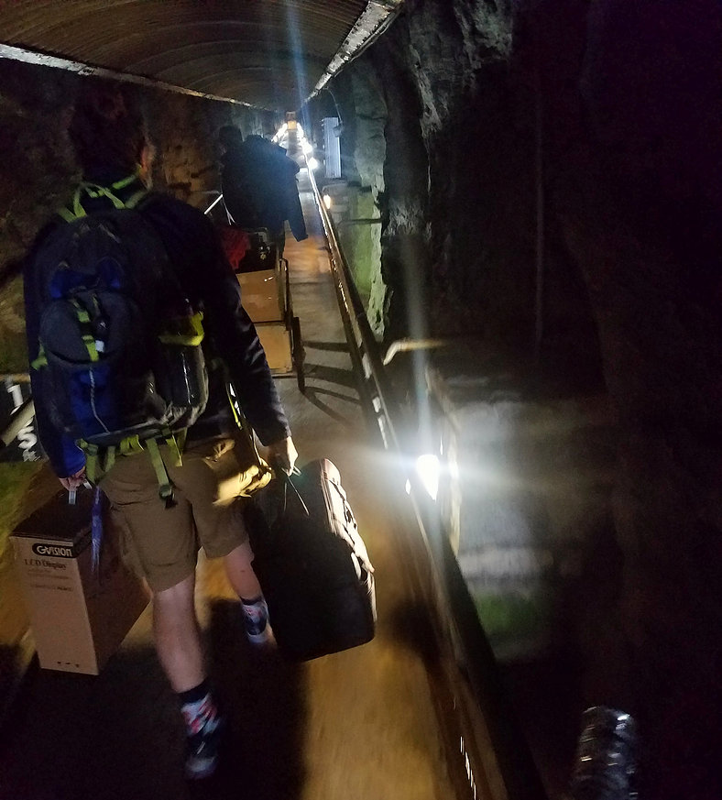
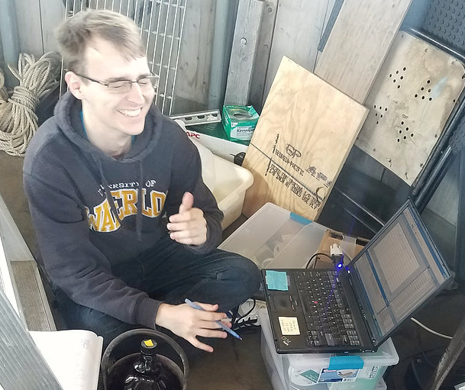
Back on June 22….

Slide 7
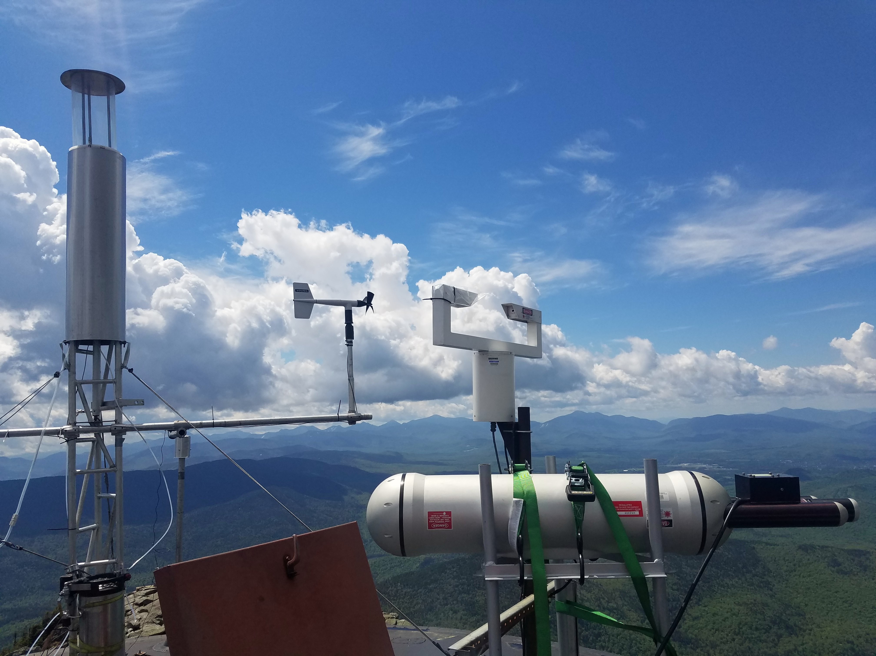
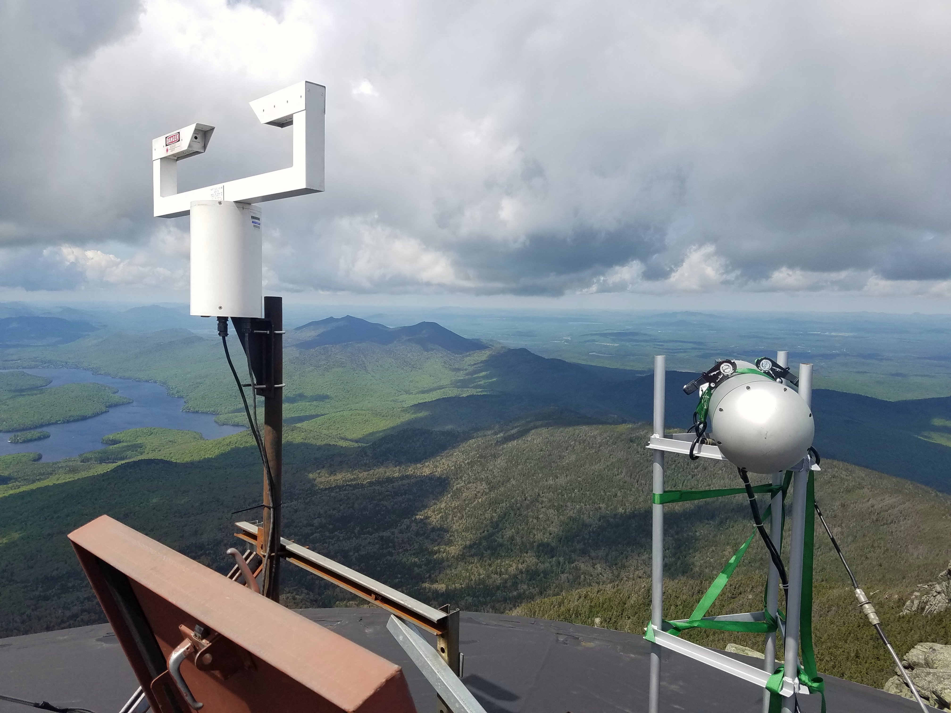
FSSP
Cloud Droplet Size Distributions

Slide 8
Summit Measurement Summary
Day |  | Aerosol | CCN | Clouds | Notes
Aug 13 | Sun | Total Number | Total Number | Tail end of am clouds | DMA broken
Aug 14 | Mon | Total Number | Total Number |  | DMA broken
Aug 15 | Tues | Size distribution | Total Number in am | FSSP measurements down from 6-10am | DMA leaking, FSSP connectivity problem
Aug 16 | Wed | Size distribution | size resolved, Calibration
Aug 17 | Thurs | Size distribution | size resolved
Aug 18 | Fri | Size distribution | size resolved
Aug 19 | Sat | Size distribution | size resolved |  | Long cloud sampling day
Aug 20 | Sun | Size distribution | size resolved
Aug 21 | Mon | Size distribution | size resolved, Calibration 10-11:30am |  | Hazy. Clear-air comparison with van
Aug 22 | Tues | Size distribution | size resolved
Aug 23 | Wed | Size distribution | size resolved

Slide 9
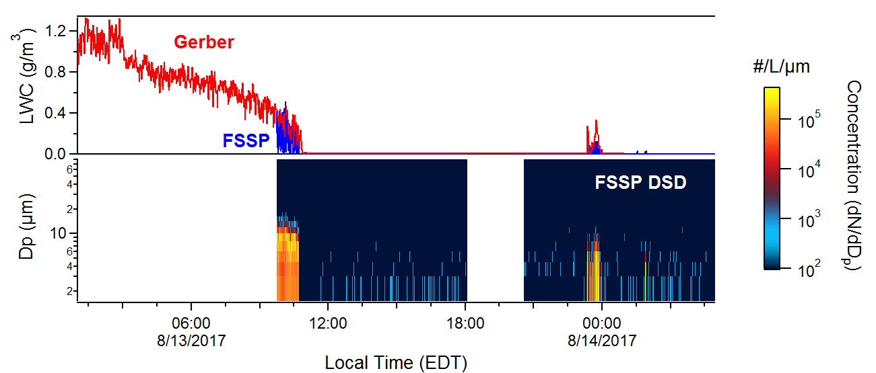

Slide 10
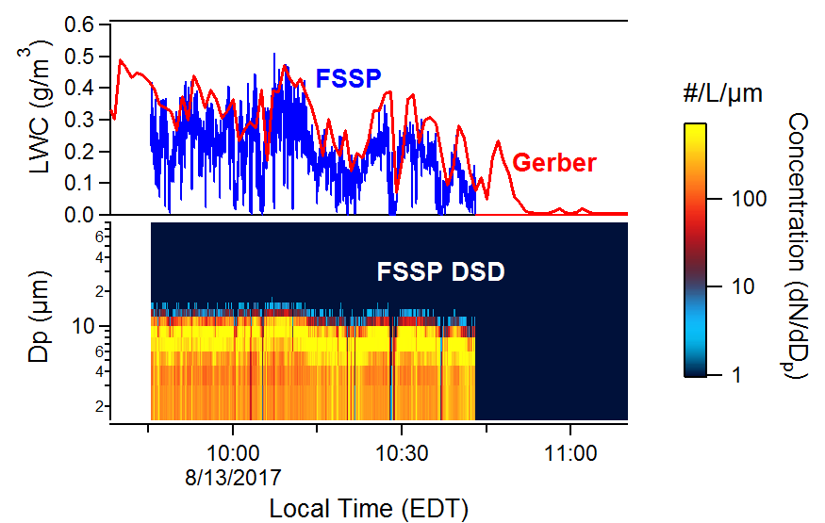

Slide 11
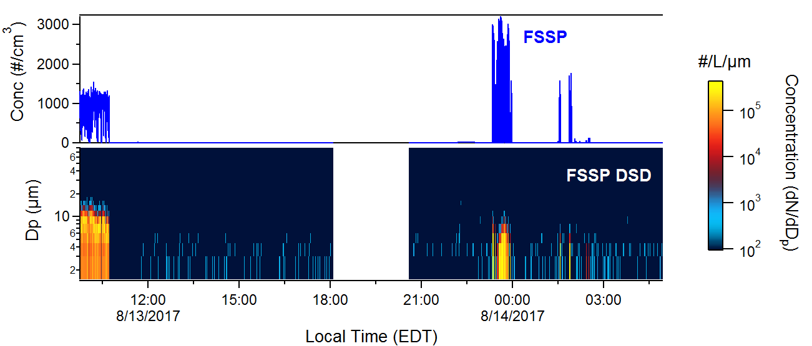

Slide 12
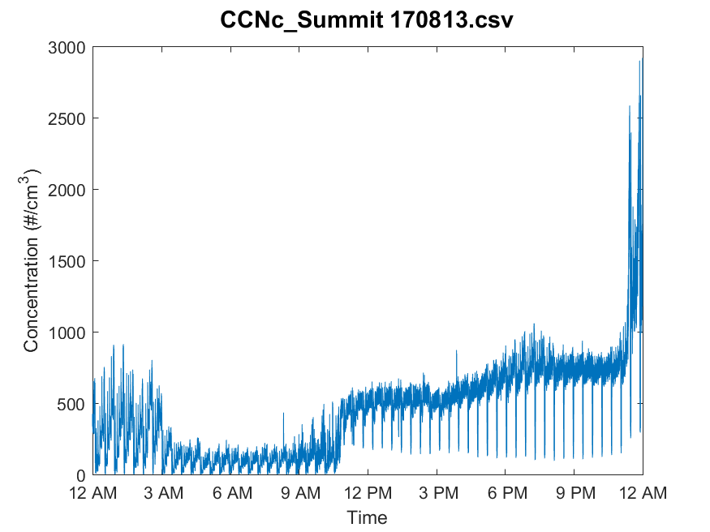

Slide 13
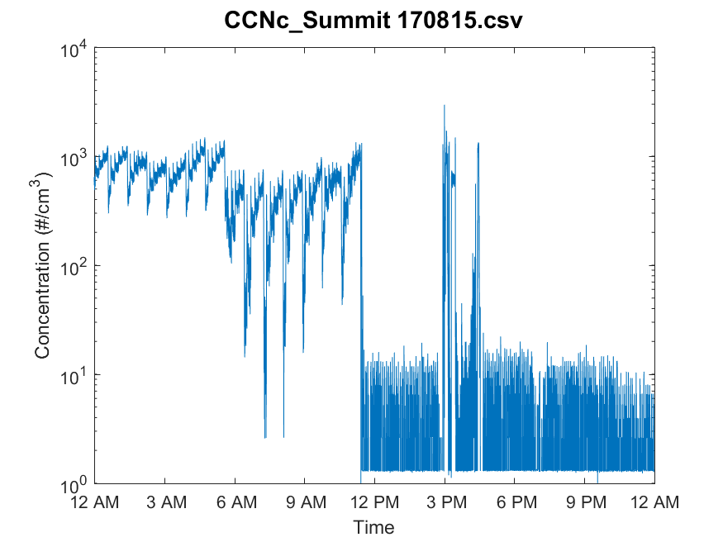

Slide 14
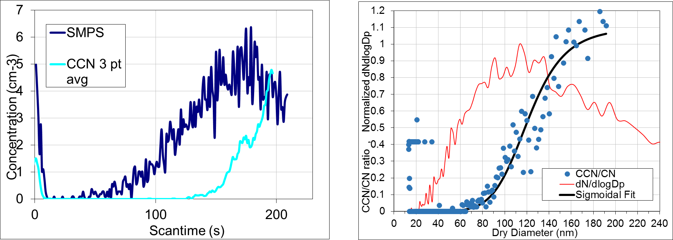
SMCA (Scanning Mobility CCN Analysis)
08/17/2017
Ambient data, averaging over 26 scans at 0.4% Supersaturation

Slide 15
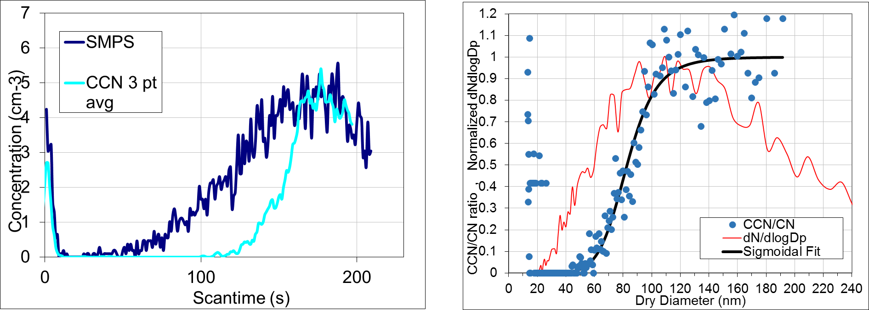
SMCA (Scanning Mobility CCN Analysis)
08/17/2017
Ambient data, averaging over 26 scans at 0.6% Supersaturation

Slide 16
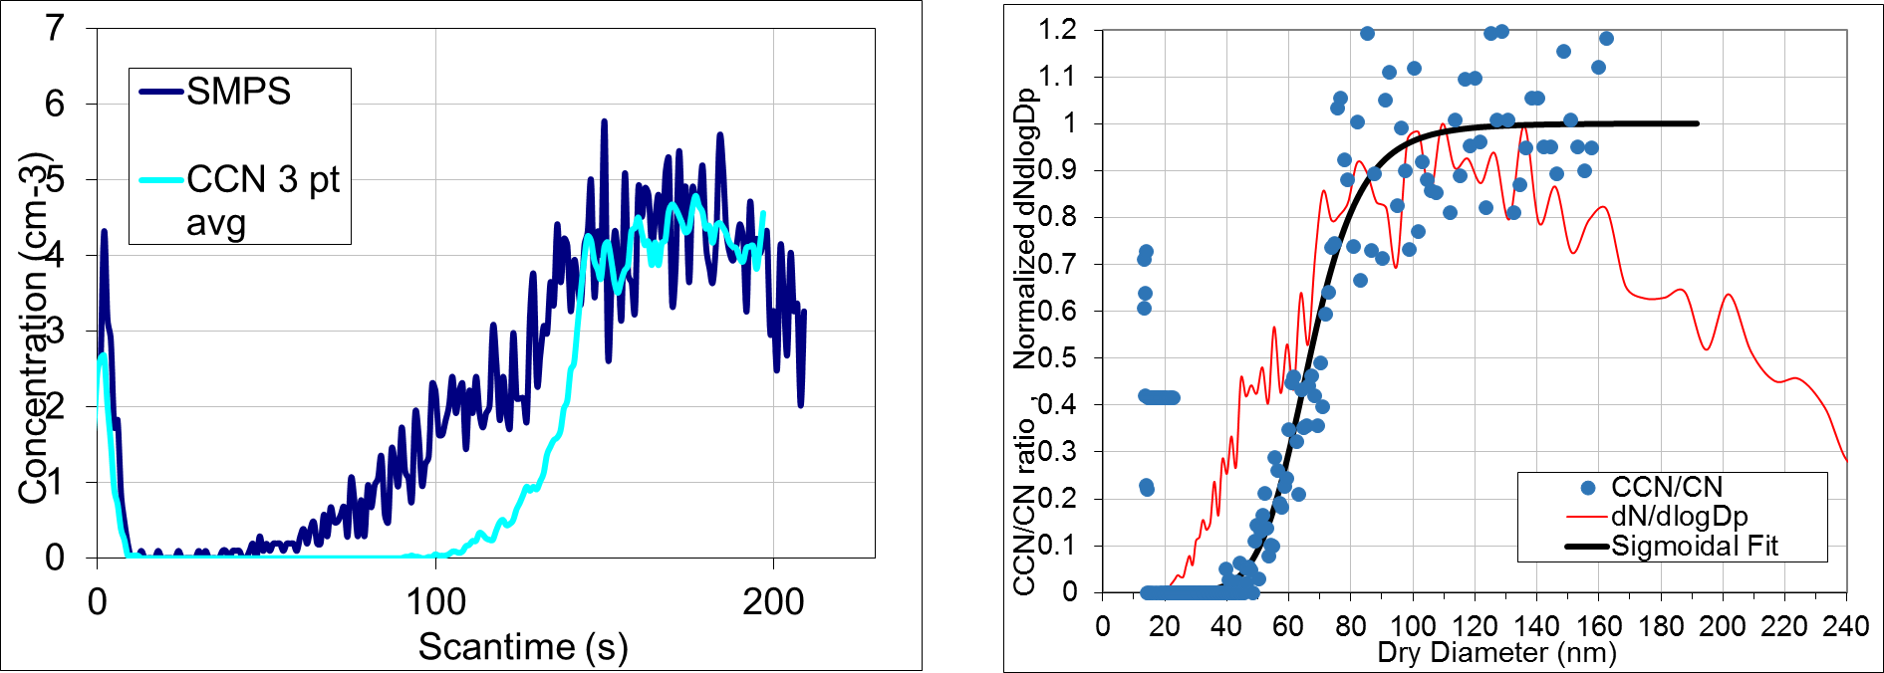
SMCA (Scanning Mobility CCN Analysis)
08/17/2017
Ambient data, averaging over 26 scans at 0.8% Supersaturation

Slide 17
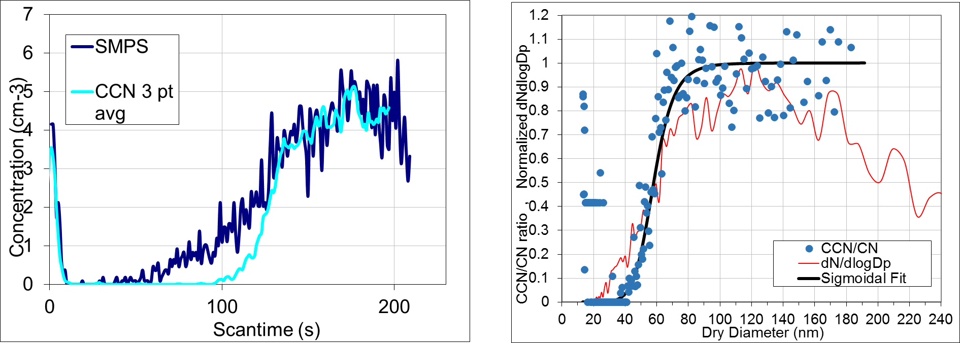
SMCA (Scanning Mobility CCN Analysis)
08/17/2017
Ambient data, averaging over 26 scans at 1.0% Supersaturation

Slide 18
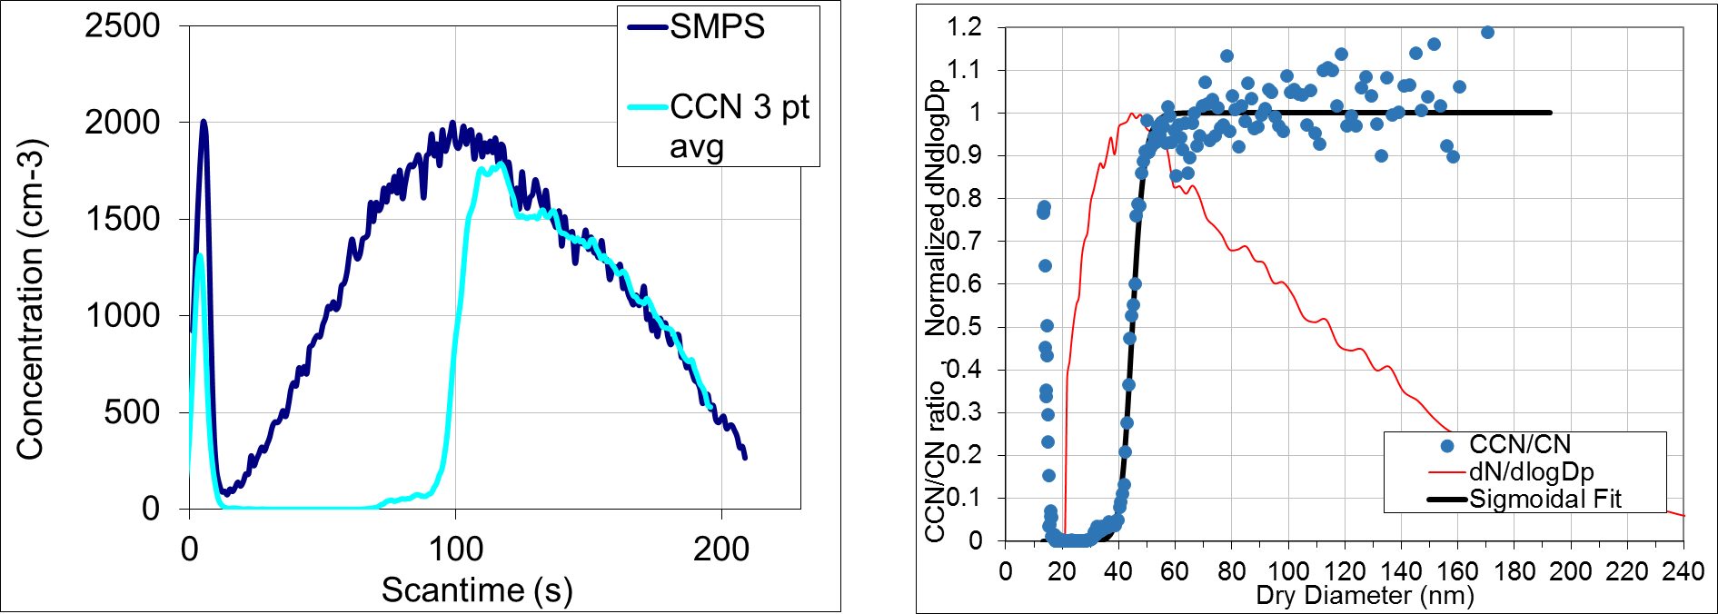
SMCA (Scanning Mobility CCN Analysis)
08/21/2017
Calibration data w/ AS, 1 scan at 0.6% Supersaturation

Slide 19
SMCA (Scanning Mobility CCN Analysis)
08/17/2017
Ambient data, averaging over 26 scans at 0.6% Supersaturation

Slide 20
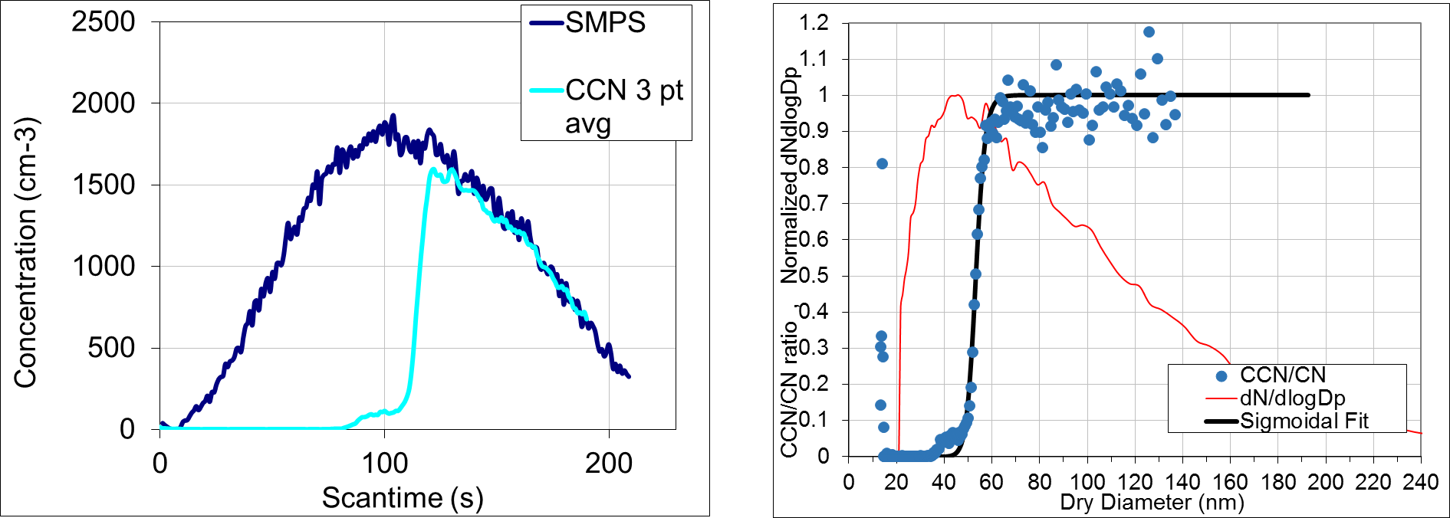
SMCA (Scanning Mobility CCN Analysis)
08/21/2017
Calibration data w/ AS, 1 scan at 0.4% Supersaturation

Slide 21
SMCA (Scanning Mobility CCN Analysis)
08/17/2017
Ambient data, averaging over 26 scans at 0.4% Supersaturation

Slide 22
Size-resolved CCN measurements = information about aerosol chemical composition
Hygroscopicity Parameter (kappa) for ammonium sulfate is ~0.6
For Organics compounds, kappa is typically < 0.2
(Petters and Kreidenweis, 2007)

Slide 23
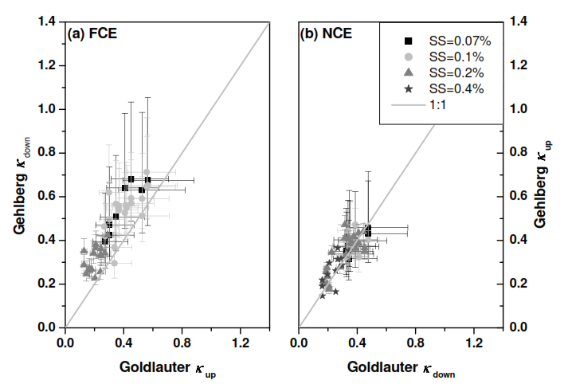
German Study Comparing Hygroscopicity Parameter (kappa) at upwind and downwind sites on cloudy and clear-air days
Full Cloud Events
Non-
Cloud
Events
(Henning et al, 2014)

Slide 24
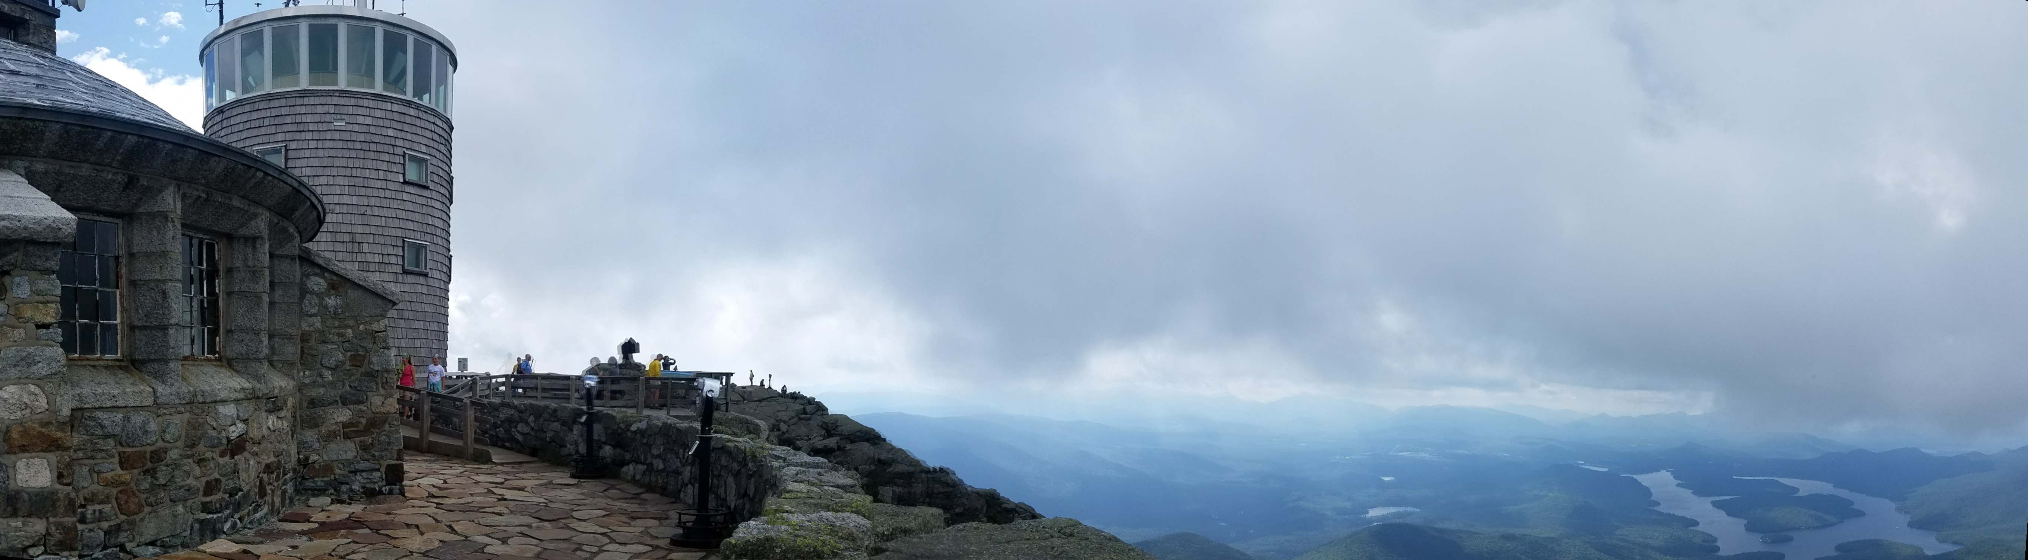

Slide 25
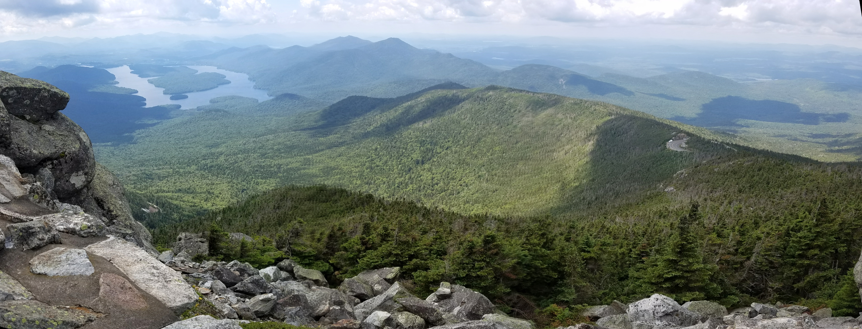

Slide 26
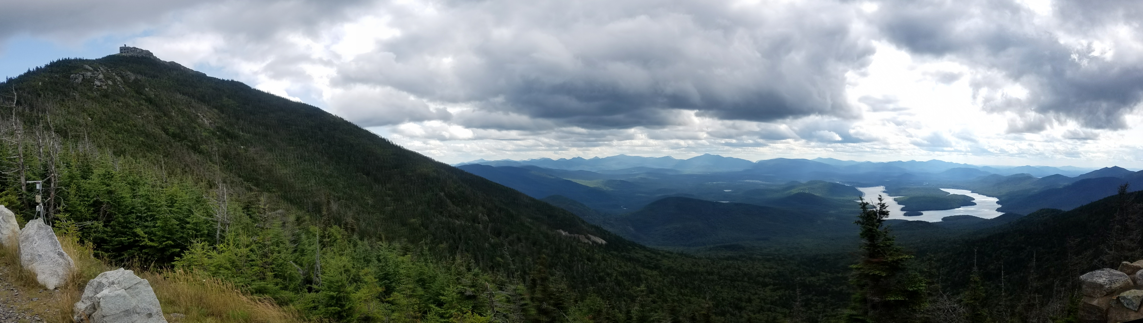

Slide 28
Principle of Operation for the CCNc
Thermal diffusivity < Molecular diffusivity of water vapor
1.
2.
3.
4.
cold
laminar
flow
Same H₂O mixing ratio
at C and B
A
A
B
B
Same temperature
at C and A
C
hot
Generates a Supersaturation
of water vapor (0.1% - 1.0 %)
CCNc Column
Notes:
Generates a supersaturation. Allows particles to activate and grow into cloud droplets. Counts the number of droplets formed.

Slide 29
Principle of Operation for the CCNc
Thermal diffusivity < Molecular diffusivity of water vapor
1.
2.
3.
4.
cold
Same H₂O mixing ratio
at C and B
droplet
activation
Same temperature
at C and A
droplet
growth
hot
Generates a Supersaturation
of water vapor (0.1% - 1.0 %)
Particle counter,
1 um lower size cutoff

Slide 30
Cloud droplet probe Sample Area
The “sample area” is defined by the optical and electronic systems of the CDP (or FSSP)
beam
dump
sample area
Qualifier
Sizer
laser
direction of airflow
Lance et al., Water droplet calibration of the Cloud Droplet Probe (CDP), 2010
Notes:
Sample area is defined by the optical and electronic systems of the CDP.

Slide 31
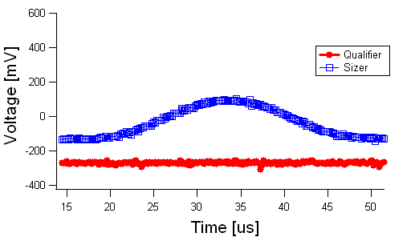
Droplets outside the Sample Area
beam
dump
Qualifier
Sizer
laser
Lance et al., Water droplet calibration of the Cloud Droplet Probe (CDP), 2010

Slide 32
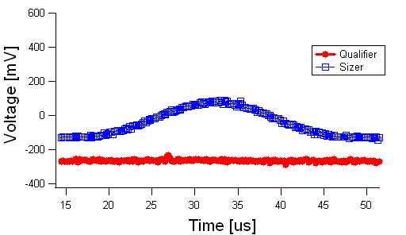
Droplets outside the Sample Area
beam
dump
Qualifier
Sizer
laser
Lance et al., Water droplet calibration of the Cloud Droplet Probe (CDP), 2010

Slide 33
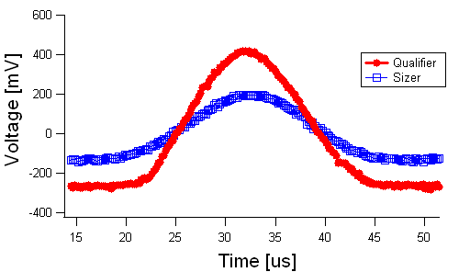
Drops inside the Sample Area
beam
dump
Qualifier
Sizer
laser
Lance et al., Water droplet calibration of the Cloud Droplet Probe (CDP), 2010

Slide 34
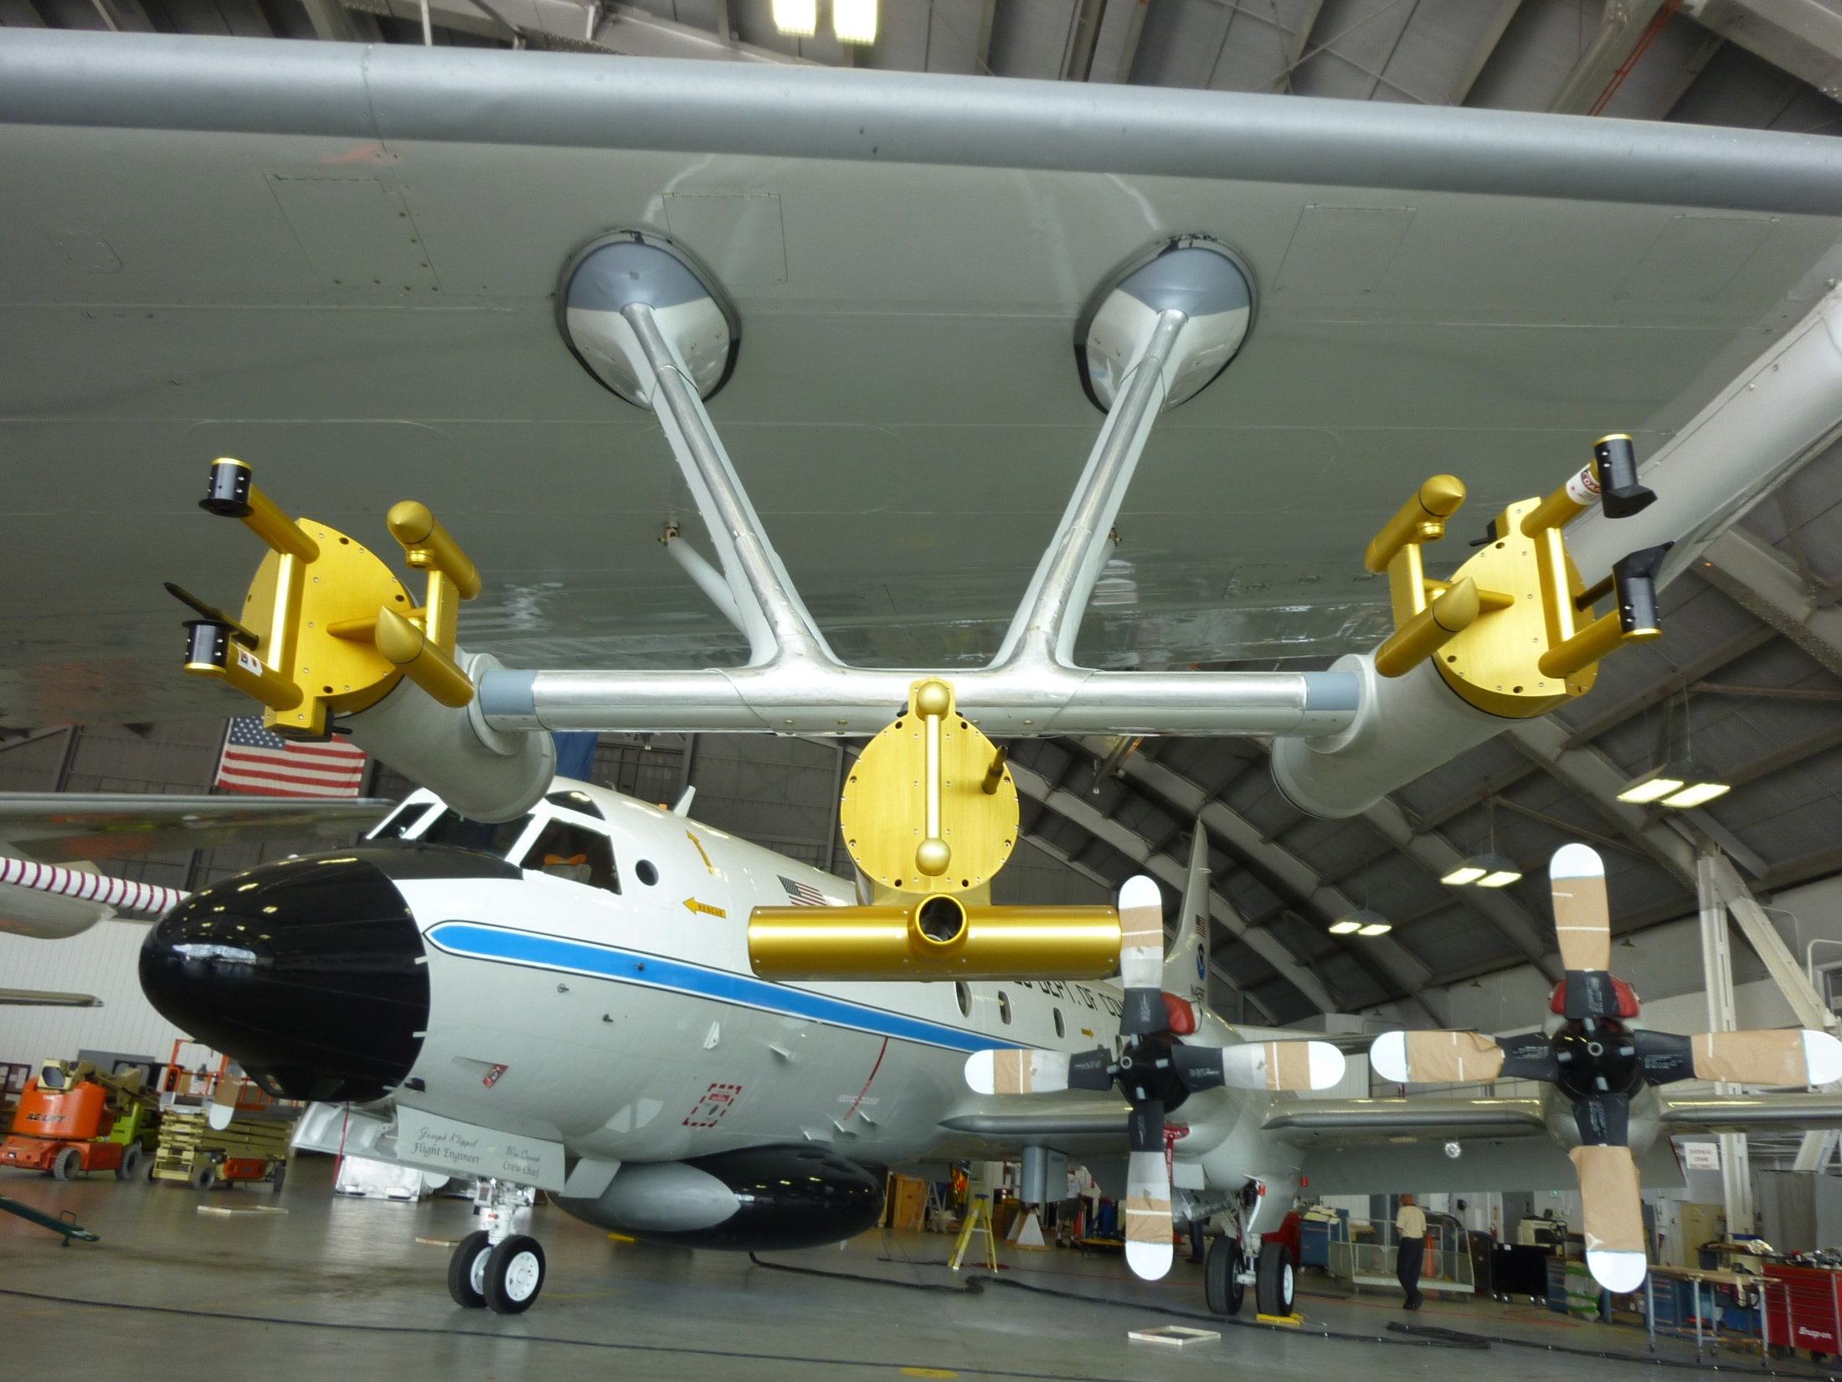
Instrumentation during the Calnex 2010 Campaign (California)
* = Modified
CIP
CDP*
CDP
CIP*
CAS

