Slide 1
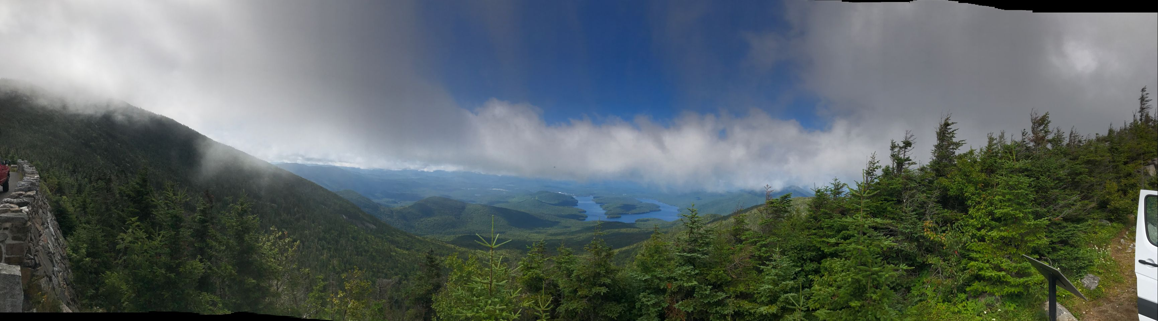
LPT aerosol measurement report

Slide 2
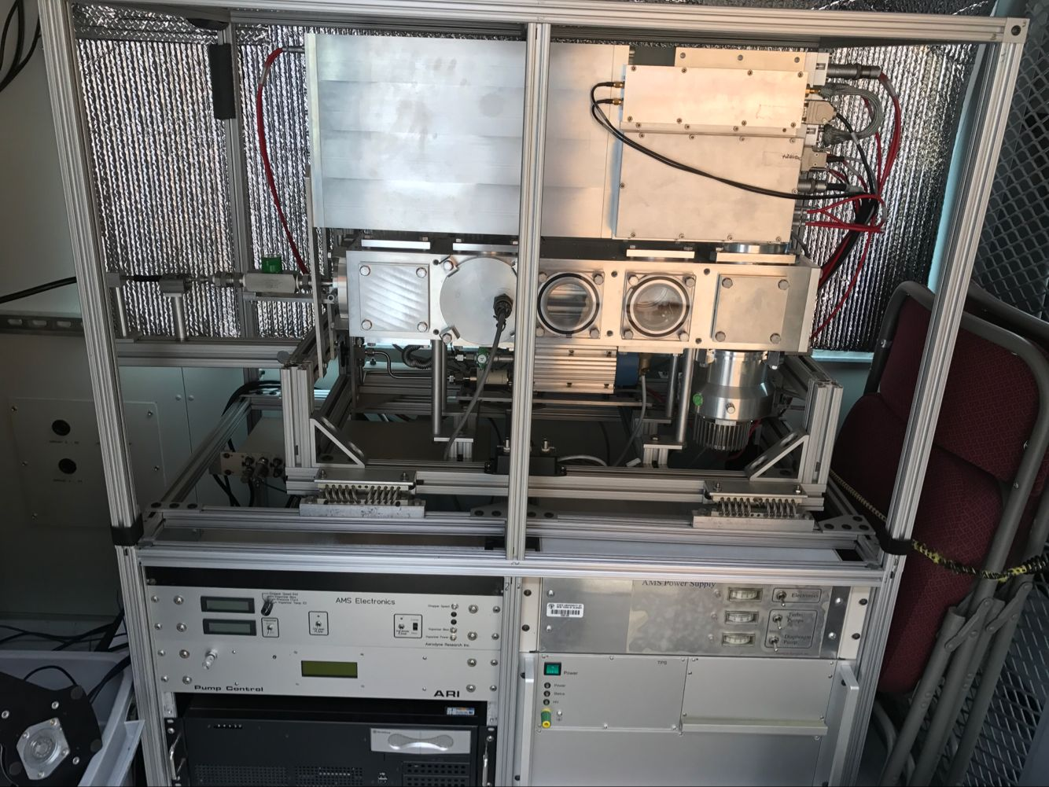
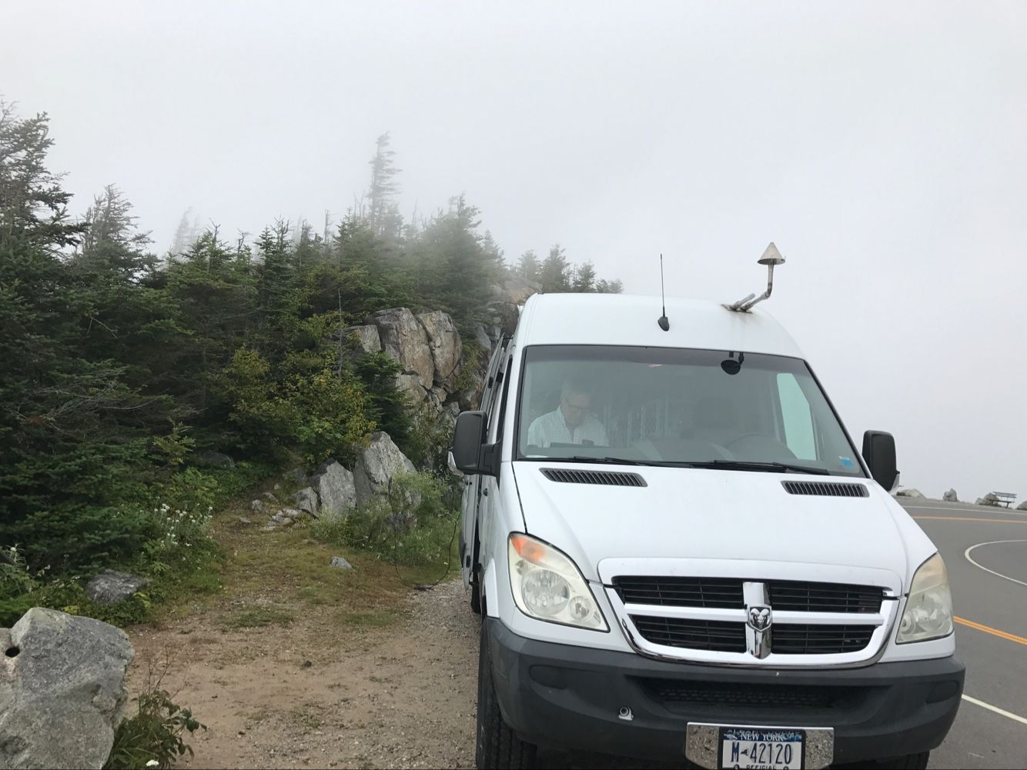
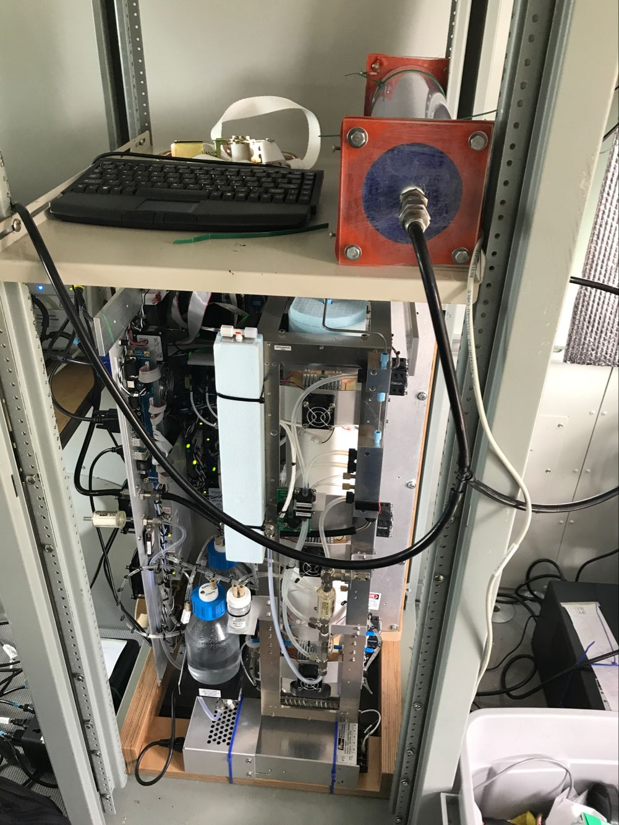
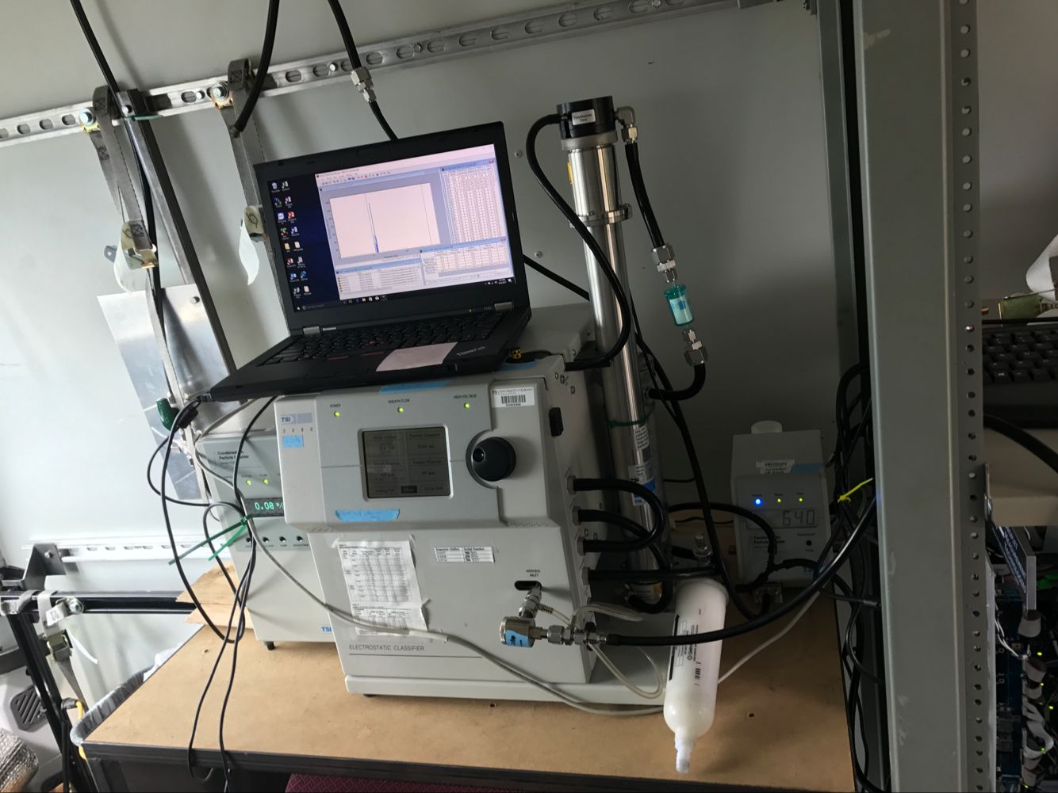
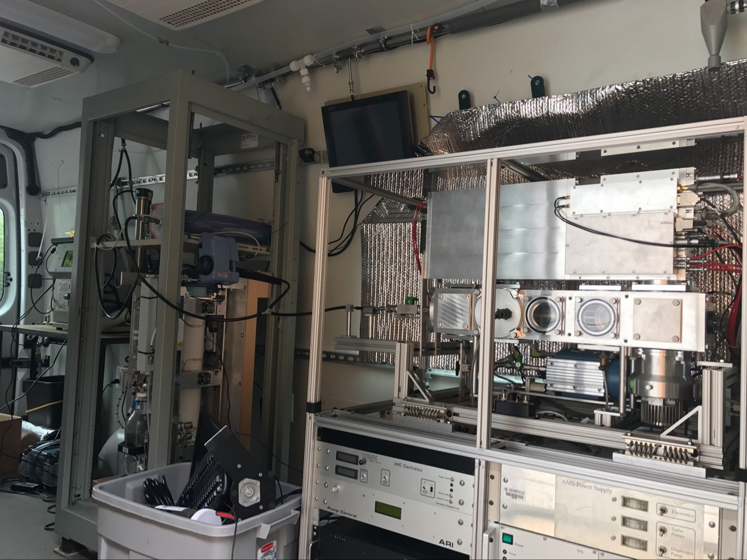
Measurement instruments:
1. AMS;
2. CCNs;
3. SMPS;
4. wcpc(3781);

Slide 3
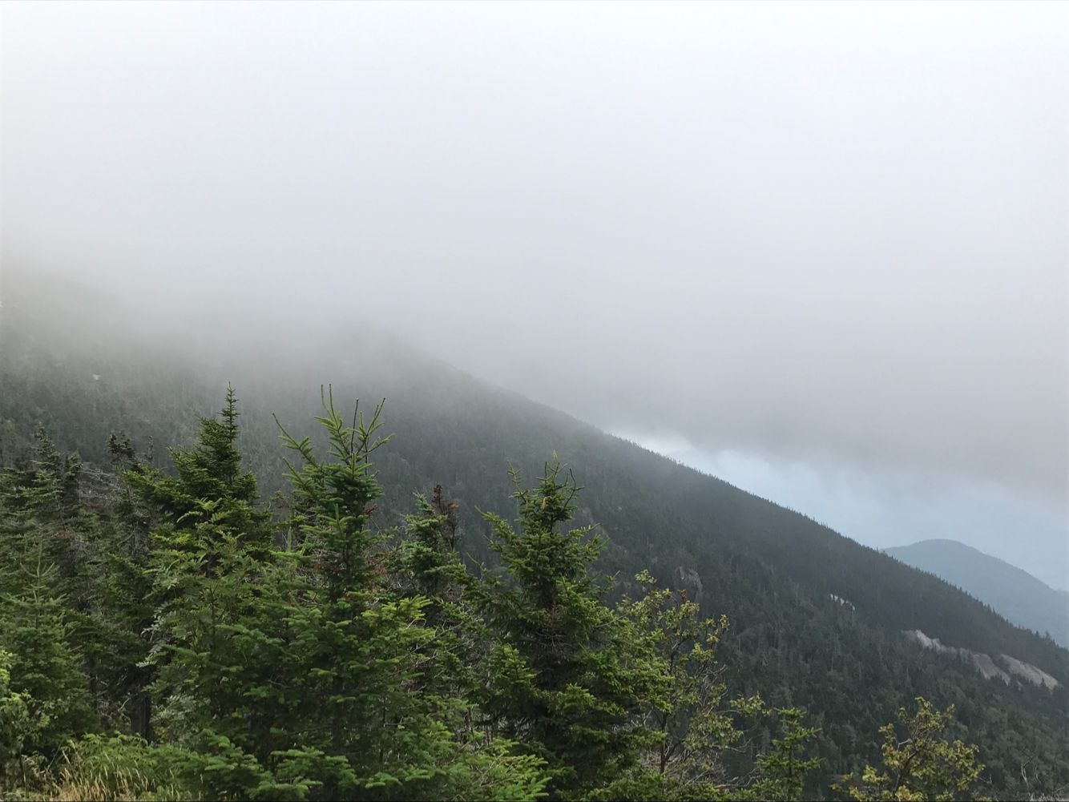
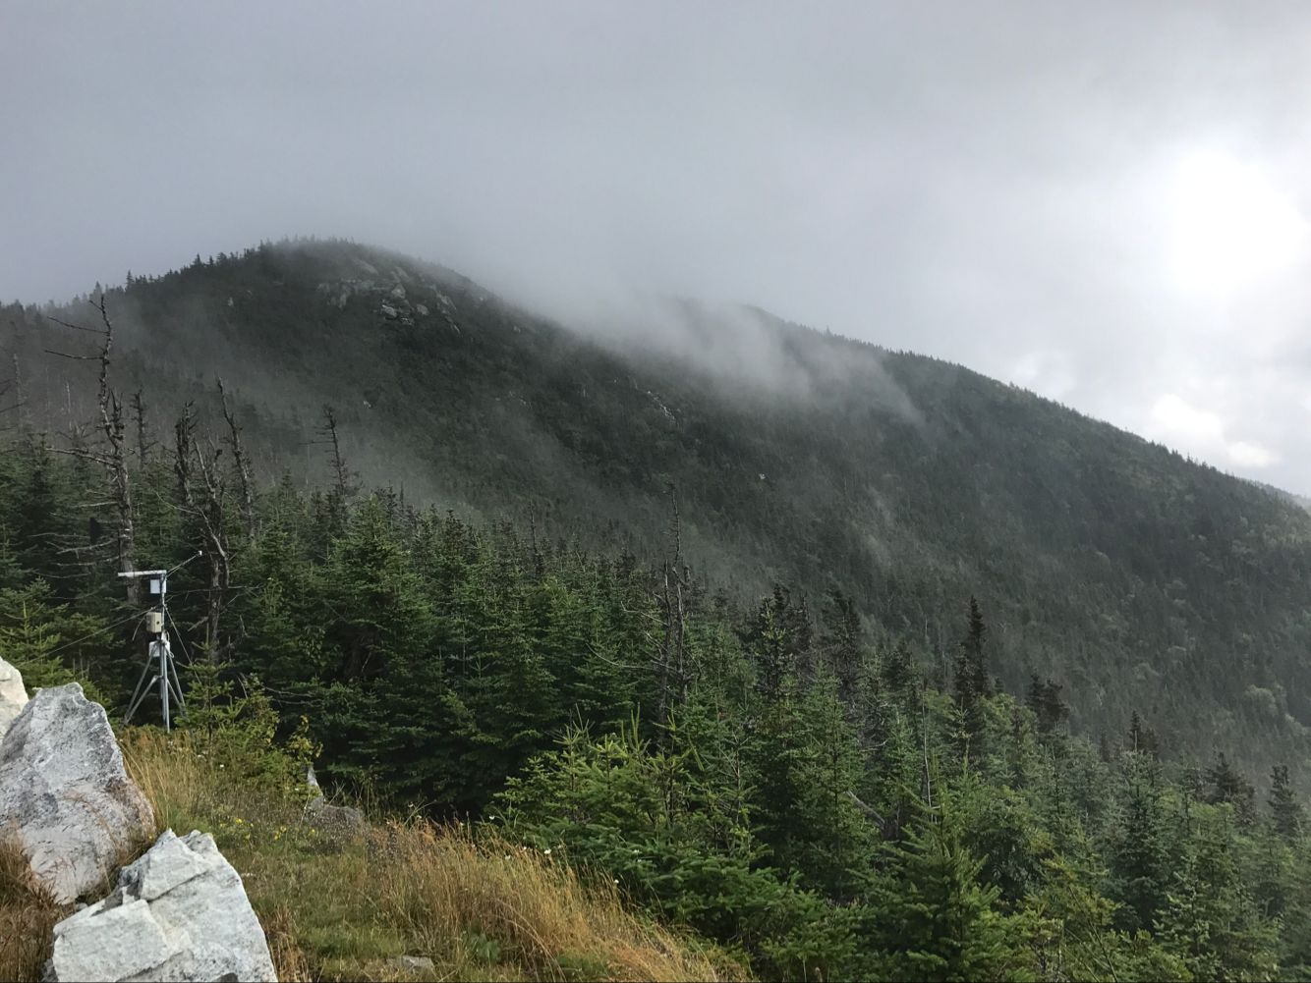
Measurement data:
1. 2017/08/13 Cloud day (*);
2. 2017/08/15 Cloud day (*);
3. 2017/08/17 Clear day ;
4. 2017/08/18 Cloud day (*);
5. 2017/08/19 Cloud day (*);
6. 2017/08/20 Cloud day (*);
7. 2017/08/21 Clear day(high);
8. 2017/08/22 Clear before Cloud;
9. 2017/08/23 Cloud day (*);
Cloud day
In Bottom Cloud (BOC)
below cloud (BLC)

Slide 4
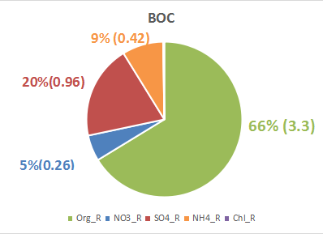
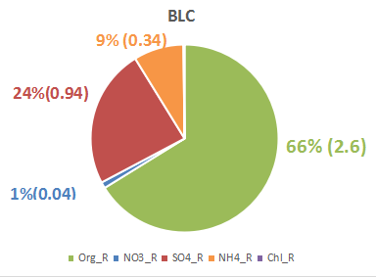
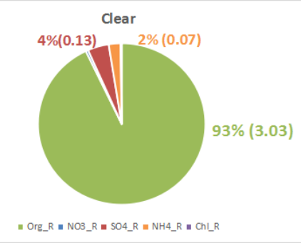
1. Aerosol composition
1: 09:00-10:30 BOC; 2: 11:30- 14:30 BLC (08/15)
15:00- 17:30 Clear (08/17)
08/17

Slide 5
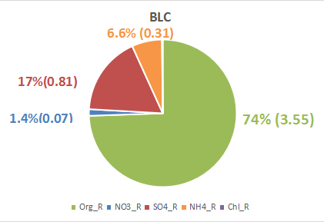
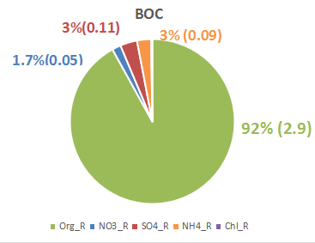
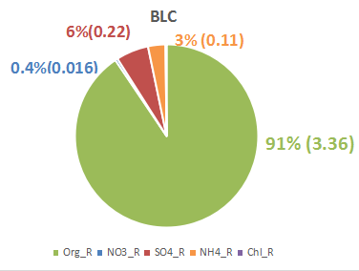
13:30-18:00 below cloud (BLC) (08/18)
1. from 10:50-11:00 BOC;2. from 11:30-after BLC (08/20)
08/20 cloud

Slide 6
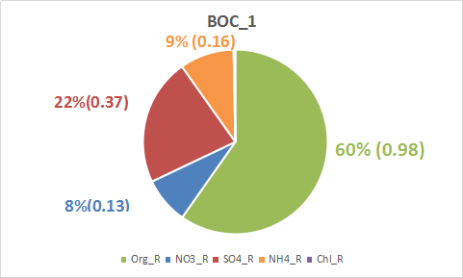
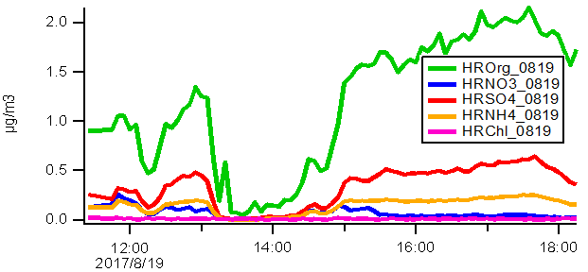
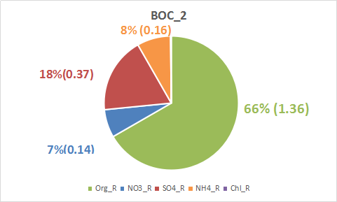
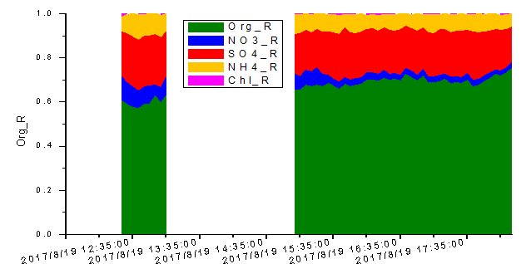
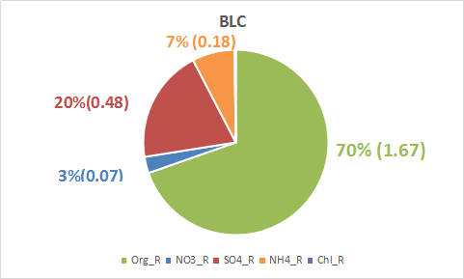
Three periods:
1. from 12:25-13:00 in Bottom Cloud (BOC_1);
2. from 14:55-15:25 in Bottom Cloud (BOC_2);
3. from 15:30-18:15 below cloud (BLC)

Slide 7
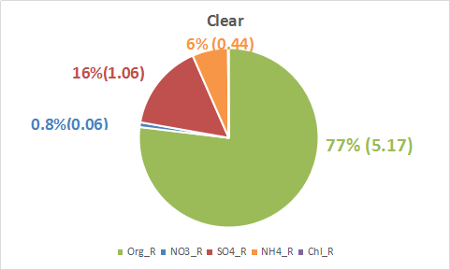
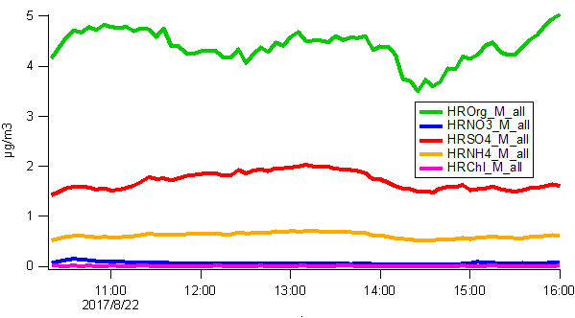
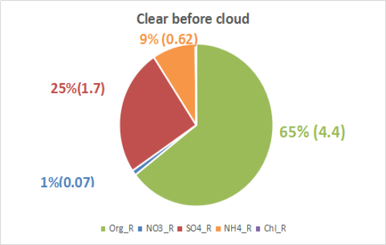

Slide 8
15
17
18
19
20
21
22
23

Slide 9
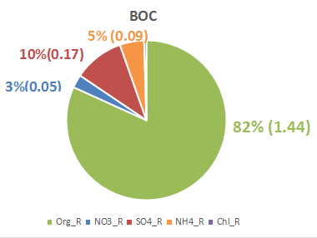
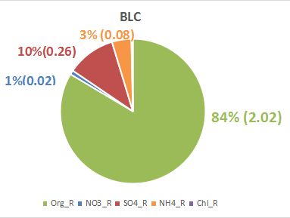
15
4.94
15
3.3
17
3.2
18
4.7
19
2.0
19
2.4
19
20
3.2
20
3.7
21
6.7
22
6.8
23
1.8
23
2.4

Slide 10
SMPS size distibution
Cloud
Clear
Cloud
Cloud
Cloud
Clear
Clear
Cloud

Slide 11
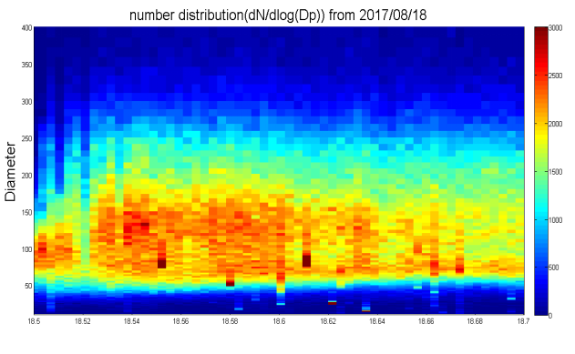
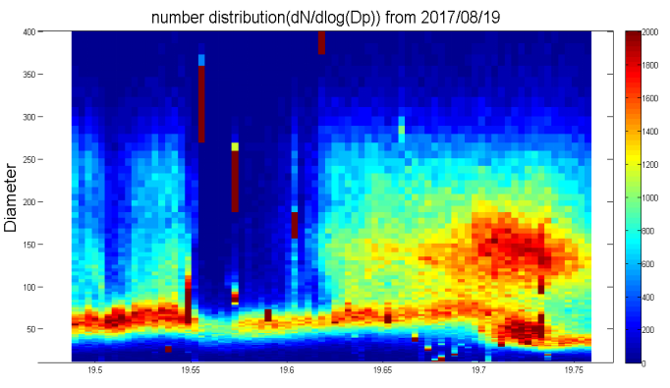

Slide 12
Organic-mass-to-organic-carbon ratios (oxygen content)

Slide 14
Thanks!

