Slide 1
Pilot Study Deployment Plan
In-situ observations at Summit
Cloud droplet size distribution, cloud water chemistry, LWC
“Between-cloud” aerosol characterization (size distribution, CCN activity)
Below-cloud aerosol characterization (from the Sprinter Van)
Aerosol composition, size distribution, CCN activity
Cloud
water
collector
FSSP
sprinter van

Slide 2
Pilot Study Deployment Plan
In-situ observations at Summit
Cloud droplet size distribution, cloud water chemistry, LWC
“Between-cloud” aerosol characterization (size distribution, CCN activity)
Below-cloud aerosol characterization (from the Sprinter Van)
Aerosol composition, size distribution, CCN activity, Ozone
Cloud
water
collector
FSSP
sprinter van

Slide 3
Pilot Study Deployment Plan
Doppler lidar – 3D wind profile, cloud base
Deployed now at ASRC
Upwind location desired (less important than proximity to the summit – tradeoff is lack of cloud base observations at summit. Would only have Wild Center camera for estimating that)
4. Radiosondes – vertical profile of RH, T, winds
8 per day on “golden days”
Cloud
water
collector
FSSP
sprinter van
Wind
lidar
radiosondes

Slide 4
Pilot Study Deployment Plan
Drone
Optical particle counter, RH, T and wind sensors
To obtain vertical profile of cloud LWC and droplet surface area
Difficulty is in obtaining FAA approval to fly in-cloud (or anywhere near cloud)…
Cloud
water
collector
FSSP
drone
sprinter van
Wind
lidar
radiosondes

Slide 5
Agenda
Introduction to Matthew and Dan (though most of you have met them already by now)
Decisions about the LIDAR and weather balloon launch locations
Weather forecasting/reporting plans for the IOP (Intensive Operations Period)
Weather tripod and met sensor deployment plans/schedule
Purchases that need to be made soon (e.g. radiosondes)
Cloud water collection (at least for this summer; the longterm plans are a bigger issue)
My next trip to the WFM with Dan (~June 19) to install aerosol instrumentation at the summit
Progress anyone wants to report or other important issues that need to be addressed.

Slide 6
~ 4860 ft
Weather Station 2
Parsivel 2?
~ 4600 ft
Sprinter Van
Weather Station 1
~ 4100 ft

Slide 9
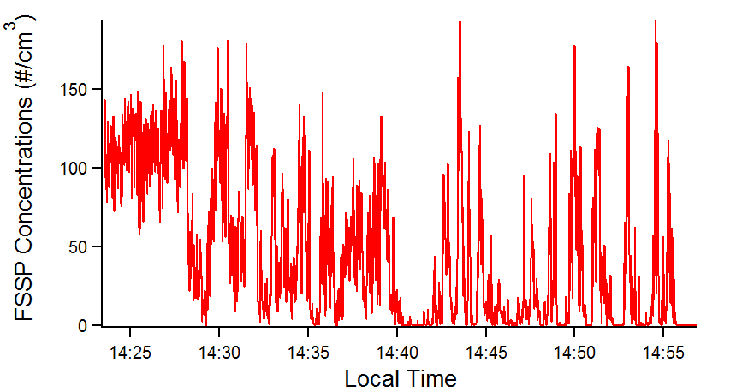
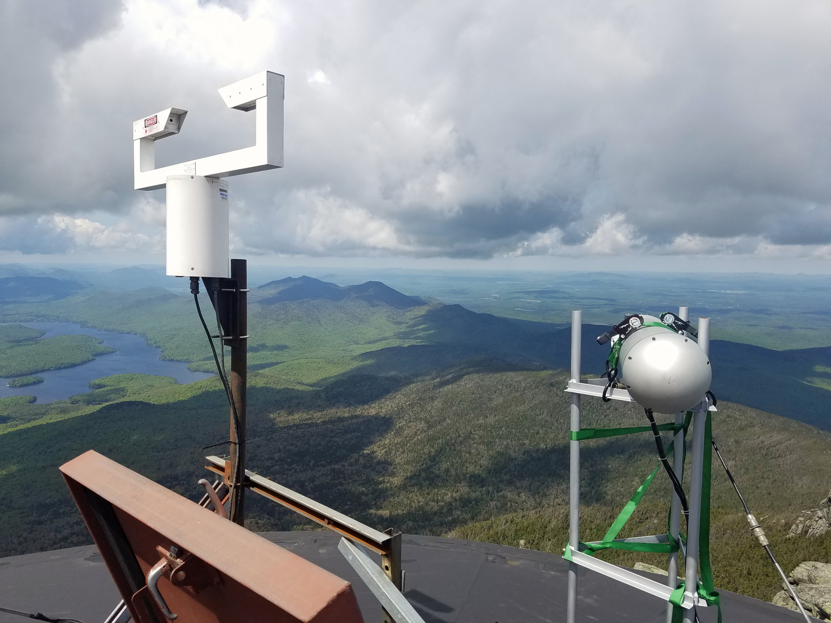
FSSP
need to compare with Gerber LWC
need to determine particle velocities
Needs to be hardened for severe weather

Slide 10
Parsivel Disdrometer
Data needs to be analyzed and compared with the Parsivel at the lodge level.
Measurements in high winds (hail on May 31) appeared to be insensitive to the hydrometeors we could see with our own eyes. (Tipping rain bucket appeared to perform even worse at the summit). Reorientation tried, but not evaluated.
We are considering the roof of the Castle (lower on the mountain) as another potential site for rain obs.

Slide 11
Instrument Install Schedule (silo)
~June 19-21
1. Aerosol inlet
To draw ambient air only when in clear-air (no clouds). Needs to be configured and installed before deployment of the following instruments:
2. SMPS (aerosol particle sizing)
For clear-air comparison to the sprinter van SMPS measurements.
Sheath pump has been replaced and flows calibrated.
3. CCN counter (http://dropletmeasurement.com/products/airborne/CCN)
Everette’s CCNc to be installed at the summit
Dan is assisting with calibration in the lab (needs to be repeated in the field, at altitude)

Slide 12
Sprinter Van
Mike Costello is working on power supply, with permission from Paul Sierzenga and Brian Frank (DEC), in preparation for deployment at WFM in late summer.
CCNc
AMS (aerosol composition): turbopump replaced and backing pump to be replaced this week (also now have a viable backing pump spare)
SMPS (particle sizing): Kr-85 radioactive source allowed if transported within the Sprinter van and used only within the van or within the WFM research facilities. Forms for deployment submitted to Eric Call (radiation safety officer).

Slide 13
AirBNB for 2 week “Intensive Operations Period”
This IOP is mainly for the sprinter van measurements (below-cloud aerosol characterization), and is limited mainly by the number of man-hours required to operate the AMS.
Will deploy the Sprinter Van in (roughly) 4-6 hour intervals (the time it takes to exhaust the batteries) and then re-charge at the lodge level. Unless a very good reason to do so, will not plan on more than 1 or 2 deployments per day (or nighttime operation).

Slide 14
AirBNB for 2 week “Intensive Operations Period”

