Slide 1
CPOC Pilot Study: Cloud Collection and Chemical Analysis
Amy Christiansen
August 24, 2017

Slide 2
Outline
Why? Giving context to cloud chemistry
How we collect cloud water
How I (and other groups) plan to analyze samples
Trends in LWC, water accumulation, wind speed

Slide 3
Cloud Processing
Organic Species in Clouds
Vertical redistribution of trace species
Medium for aqueous-phase oxidation of volatile organic carbons
Oxidation chemistry
$${Fe}^{2+} \left(or {Cu}^{+}or {Mn}^{2+}\right)+ H_{2}O_{2} \left(+hν\right)→ OH+ {OH}^{−}+{Fe}^{3+} \left(or {Cu}^{2+}or {Mn}^{3+}\right)$$
multiphase chemistry
•OH
•OH
O₃
SO₂
•OH
NO_{x}
WSOGs
O₃
BIOGENIC
ANTHRO
Notes:
Once in clouds, get radiative impacts (particles scatter and absorb incoming solar radiation and light backscattered from clouds), transport of pollutants

Slide 4
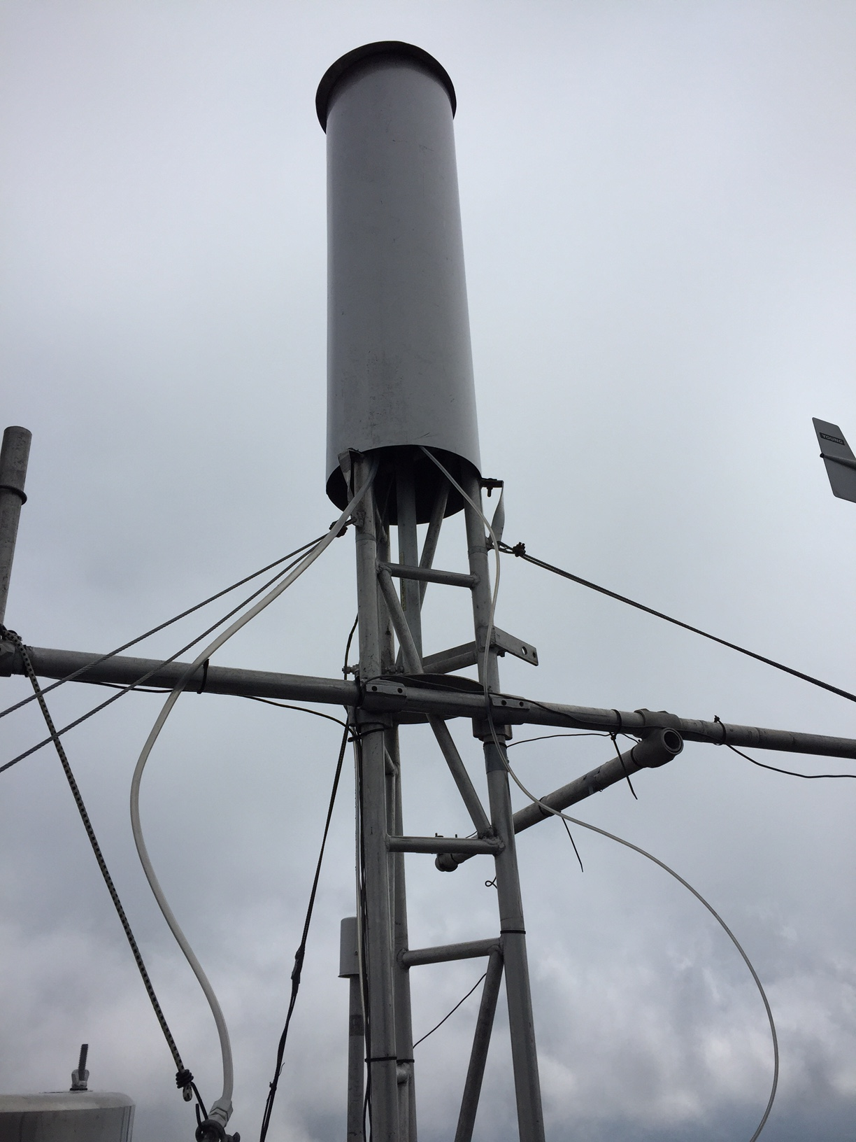
Cloud collecting system
LWC is 0.05 g m⁻³ or greater
Wind speed is 2 m s⁻¹ or greater
Temperature is 2 ºC or greater
Heated grid rain sensor indicates no rain

Slide 5
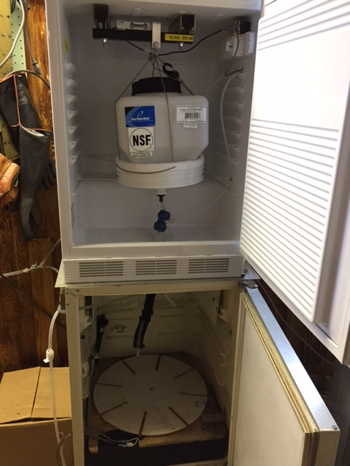
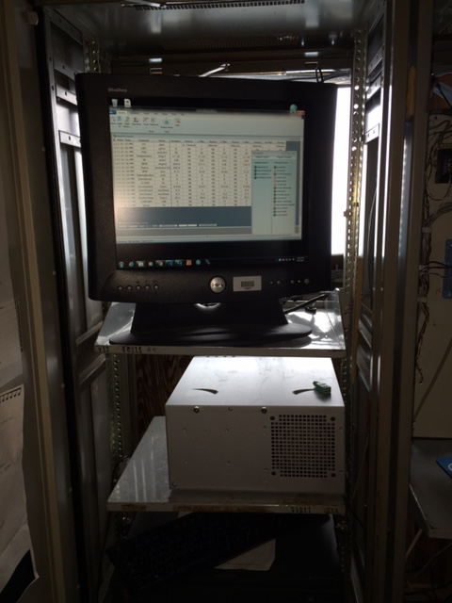
Cloud collecting system
Notes:
Overnight sample: 250 mL to ALSC, rest to me
Hourly samples: half to ALSC (get combined into 12-hour sample), half to me, ALSC gets 250 mL for sure (was never an issue when we sampled)

Slide 6
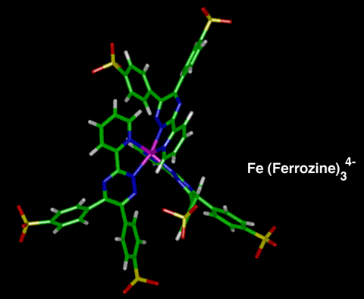
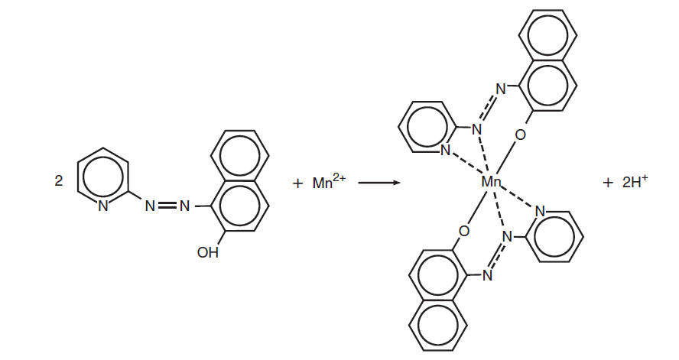
Chemical Analysis
Fe(II) analysis
Complex with ferrozine
Measure absorbance at 562 nm with UV-Vis spectrometer
Cu(I) analysis
Complex with bathocuproinedisulfonic acid
Measure absorbance at 482 nm with UV-Vis spectrometer
Mn(II) analysis
Complex with 1-(2-Pyridylazo)-2-naphthol
Measure absorbance at 553 nm with UV-Vis spectrometer
http://www.chemistry.wustl.edu/~edudev/LabTutorials/Ferritin/feferr.html
Hach company 2007
Notes:
Ferrozine image: http://www.chemistry.wustl.edu/~edudev/LabTutorials/Ferritin/feferr.html
Mn(ii) image: Hach company, 2007

Slide 7
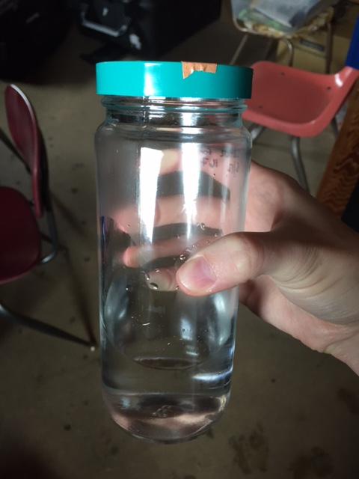
Chemical Analysis
Total concentrations
High-resolution inductively-coupled plasma mass spectrometer
Identify carboxylic acids found in previous field and lab studies
Analyze via HPLC for identities and concentrations

Slide 8
Anticipated Impact of Results
Increase understanding of in-cloud oxidation processes and extent to which transition metals contribute to the oxidative capacity of cloud droplets
Improve atmospheric models that predict organic acid concentrations through inclusion of transition metal oxidation reactions
Improve understanding of effect of cloud processing on the concentrations and species of organic acids found in cloud water

Slide 9
Other groups
Sergey Nizkorodov (UCI): Environmental Molecular Sciences Laboratory at Pacific Northwest National Lab
Chris Hennigan (UMBC): Water-soluble organo-nitrogen compounds
Cari Dutcher (U of M): Surface droplet tension with micro fluid techniques
Drew Gentner (Yale): 2D GC/MS
Notes:
UMBC=University of Maryland Baltimore County

Slide 10
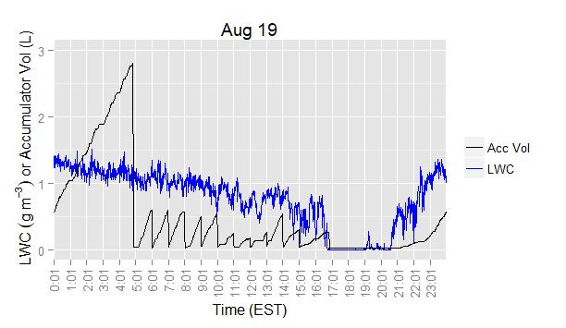
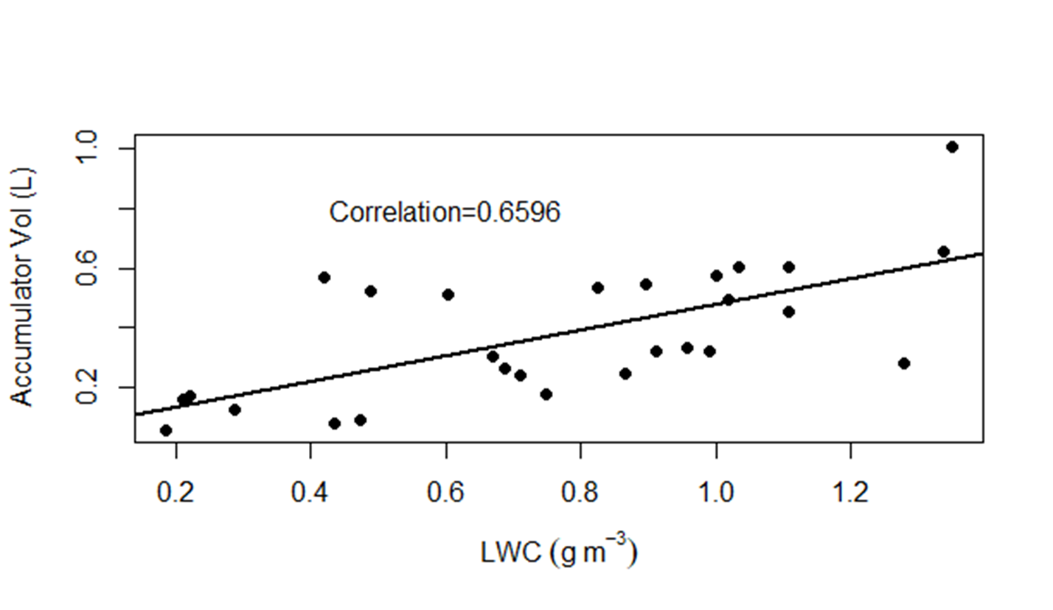
Trend between LWC and accumulator volume

Slide 11
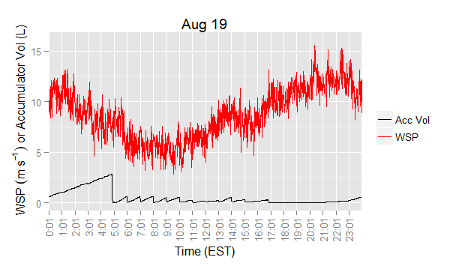
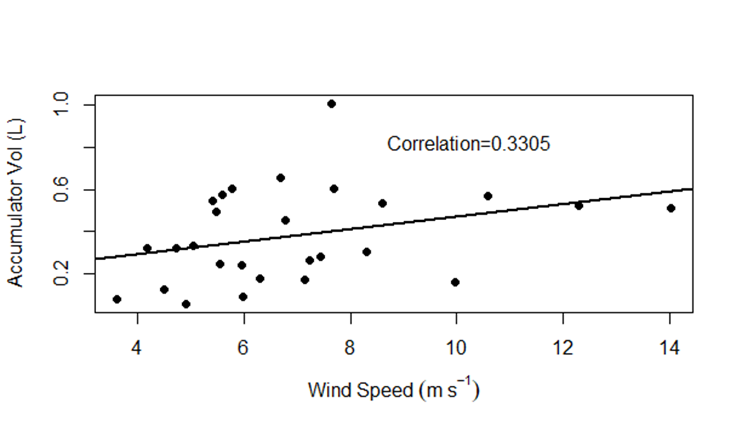
No strong trend between wind speed and accumulator volume, but wind may play a role

Slide 12
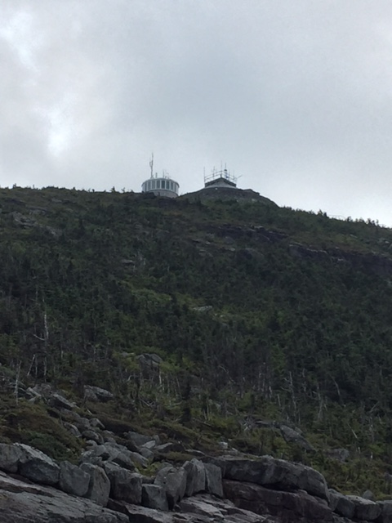

Slide 13
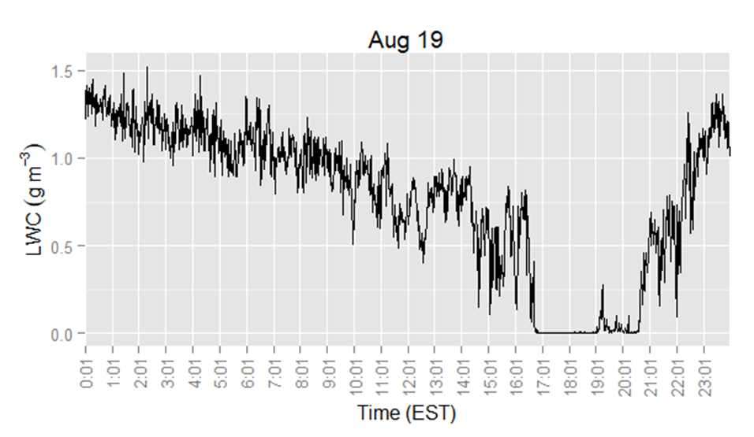
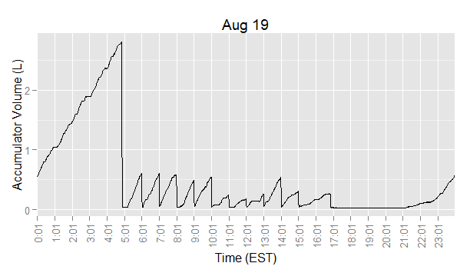

Slide 14
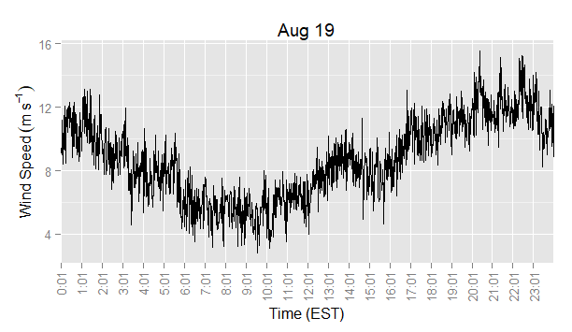
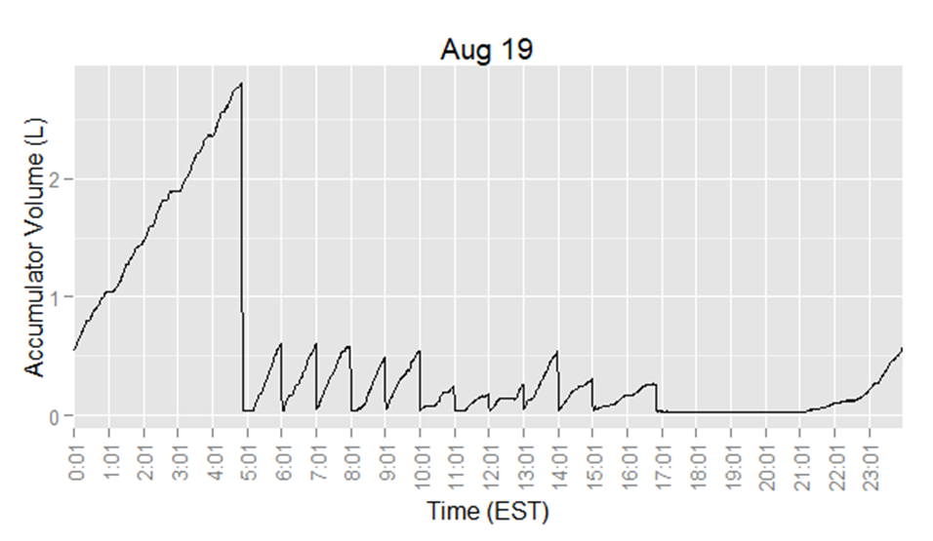

Slide 15
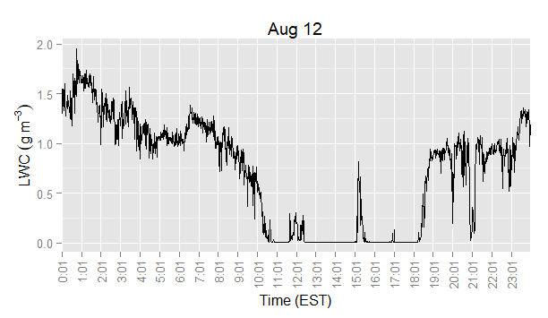
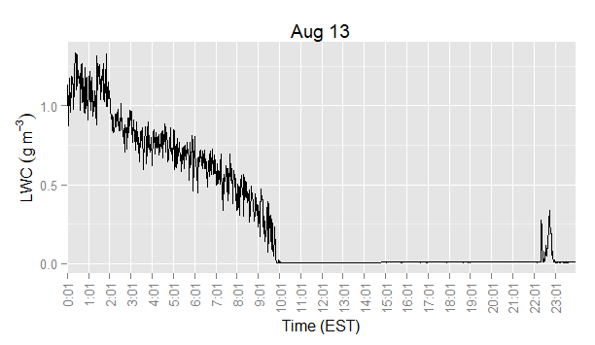
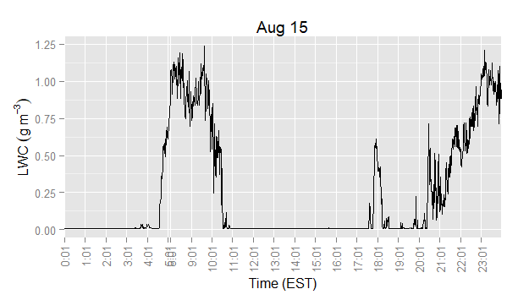
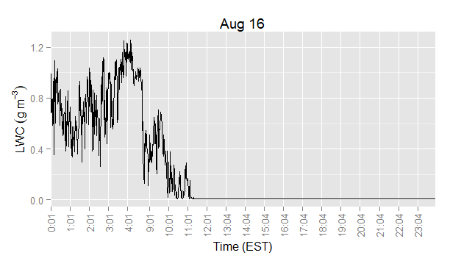

Slide 16
