Slide 1
CPOC Pilot Study: Transition Metals Update
Amy Christiansen
March 15, 2018

Slide 2
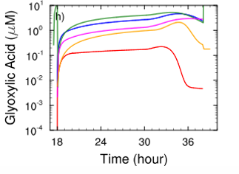
Cloud Processing
Organic Species in Clouds
Vertical redistribution of trace species
Medium for aqueous-phase oxidation of volatile organic carbons
multiphase chemistry
•OH
•OH
O₃
SO₂
•OH
NO_{x}
WSOGs
Oxidation chemistry
$${Fe}^{2+} \left(or {Cu}^{+}\right)+ H_{2}O_{2} \left(+hν\right)→ OH+ {OH}^{−}+{Fe}^{3+} \left(or {Cu}^{2+}\right)$$
O₃
BIOGENIC
ANTHRO
Organic acid production in models inconsistent
Barth, Ervens, and McNeill Model Intercomparison, 2017
Notes:
Put in pictures from model intercomparison, choose some acids
Mention that chemical reaction is barebones and that many complexes can form and participate in these reactions
Mention where metals come from
Once in clouds, get radiative impacts (particles scatter and absorb incoming solar radiation and light backscattered from clouds), transport of pollutants
Cloud processing poorly understood; Organic acid concentrations cannot be accurately modeled

Slide 3
Cloud Water Chemical Composition
Increase understanding transition metal effects on the concentrations and species of organic acids found in cloud water
Collect and analyze cloud water samples from Whiteface Mountain, NY, for transition metal oxidation states and concentrations, and organic acids

Slide 4
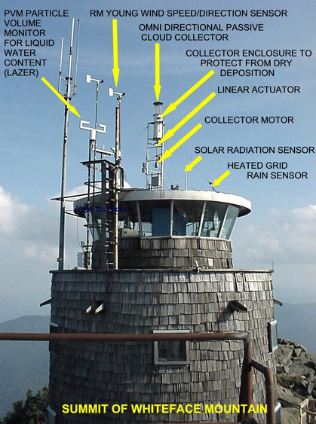
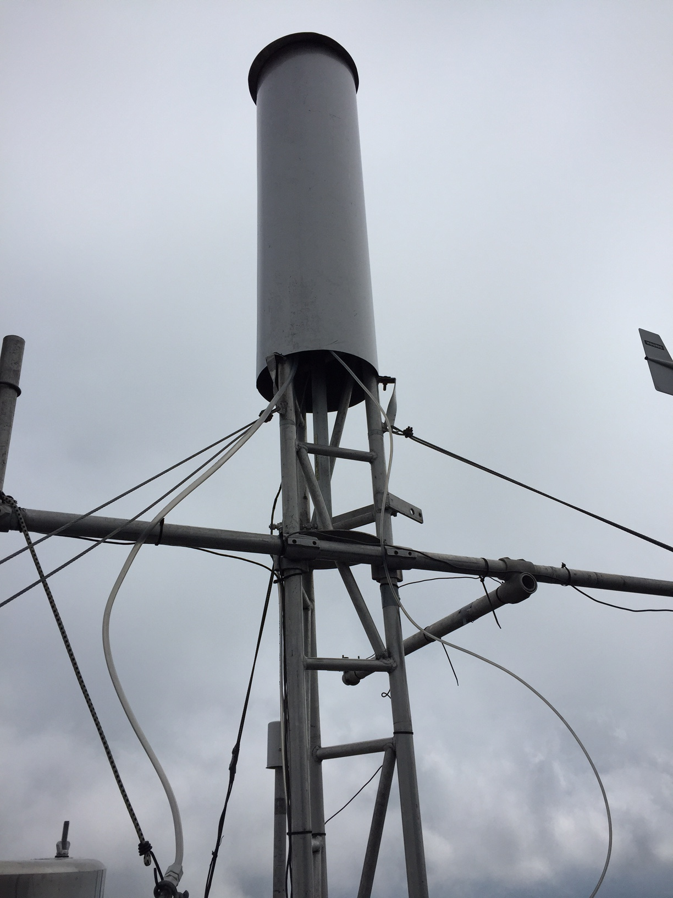
Cloud collection system
Liquid water content (LWC) is 0.05 g m⁻³ or greater
Wind speed is 2 m s⁻¹ or greater
Temperature is 2 ºC or greater
Heated grid rain sensor indicates no rain
http://www.adirondacklakessurvey.org/wfc.shtml

Slide 5
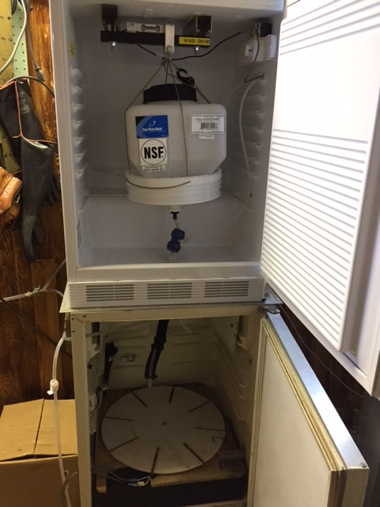
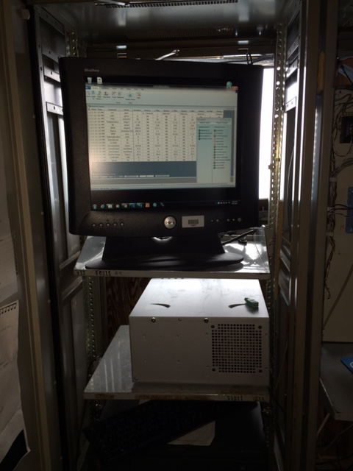
Cloud collection system
Notes:
Overnight sample: 250 mL to ALSC, rest to me
Hourly samples: half to ALSC (get combined into 12-hour sample), half to me, ALSC gets 250 mL for sure (was never an issue when we sampled)

Slide 6
Transition Metal Oxidation States
Fe(II) analysis
Complex with ferrozine in ammonium acetate buffer
Measure absorbance at 562 nm with UV-Vis spectrometer
Cu(II) analysis
Complex with polyethyleneimine (PEI) in citrate buffer
Measure absorbance at 280 nm with UV-Vis spectrometer
NOTE: Freezer issues means numbers obtained are not representative of atmospheric conditions
Notes:
Ferrozine image: http://www.chemistry.wustl.edu/~edudev/LabTutorials/Ferritin/feferr.html
Mn(ii) image: Hach company, 2007

Slide 7
Results from Photometric Analysis
Most Fe(II) samples below instrument detection limits
All Cu(II) samples below instrument detection limits
Currently working on method detection limits
Sample ID | Date and Time (EST) | Concentration (nM)
17223X1 Rinse | 8/11/17 | 387
1722408 | 8/12, 11a-12p | 243
1723104 | 8/19, 8-9a | 196
1723111 | 8/19-8/20, 5p-5a | 196
1723204 | 8/20, 10-11a | 386
*Siefert et al. 1998 measured Fe(II):
-Fe(II) concs were same order of mag, but some in 1000s of nM
Notes:
Finding Fe in rinse means that some metals are likely in sampling lines. How does this compare to concentrations found by Siefert? Also mention detection limits. Were any in non-glass containers? Note that these number can’t really be trusted (freezer breaking, storage effects, etc.), but we do show that we can definitely detect these metals with these methods. Also proved that we can ship these samples without destroying them.

Slide 8
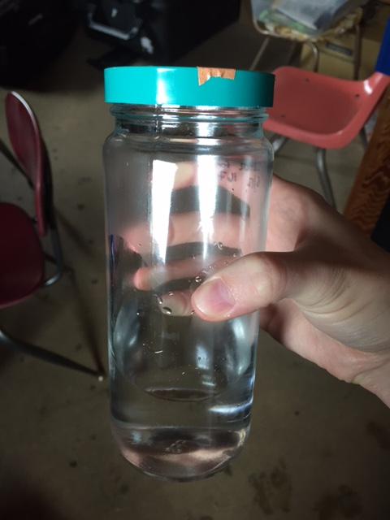
Future Analysis
Total concentrations
High-resolution inductively-coupled plasma mass spectrometer (Johnson group, UCI)
Obtain Fe(III) and Cu(I) concentrations by difference
Identify carboxylic acids
Analyze via LC-MS for identities and concentrations (Saltzman group, UCI)
Notes:
Which carboxylic acids do you expect to see?

Slide 9
Future Improvements on Analysis
Measure concentrations immediately for oxidation state analysis
Reduce storage time for total metals analysis
Notes:
Feasible for Fe(II) and Cu(II) concentrations; will need to ship samples and have them run on ICP-MS immediately upon receipt to minimize storage losses. Currently testing storage loss.

Slide 10
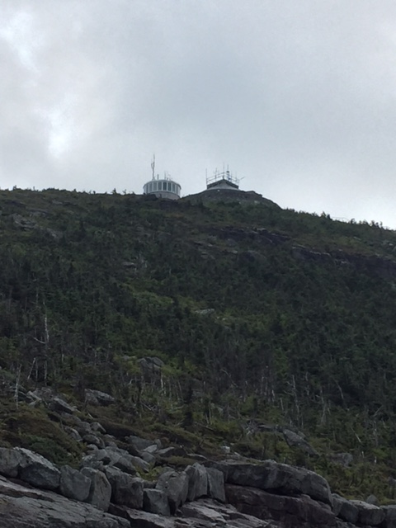

Slide 11
Fine particulate matter (PM_{2.5})
Complex matrix that includes organic acids
Oxidation of volatile organic carbons
Clouds transport pollutants from boundary layer to free troposphere
Hard to sample clouds
multiphase chemistry
•OH
•OH
O₃
SO₂
•OH
NO_{x}
WSOGs
O₃
BIOGENIC
ANTHRO
https://www.nasa.gov/centers/armstrong/news/FactSheets/FS-046-DFRC.html
Notes:
Mention how models underpredict scattering and organic carbon aloft (above cloud deck) because they don’t include cloud processing, subsequent impacts not well characterized (models consistently underpredict organic carbon aloft because cloud processing not included/not well understood, predictions of scattering above clouds not understood because measurements above cloud not available)
Aloft aerosols above clouds:
scatter diffuse backscatter
subject to less removal processes
Vertical redistribution of trace species
Medium for aqueous-phase oxidation of volatile organic carbons

Slide 12
Motivation
Increase understanding of in-cloud oxidation processes and extent to which transition metals contribute to the oxidative capacity of cloud droplets
Improve atmospheric models that predict organic acid concentrations through inclusion of transition metal oxidation reactions
Improve understanding of effect of cloud processing on the concentrations and species of organic acids found in cloud water

