Slide 1
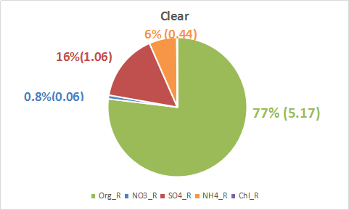
08/21 Clear

Slide 2
Mass Spectra

Slide 3
SMPS size distribution

