Slide 1
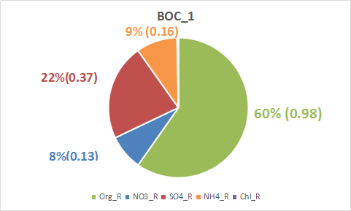
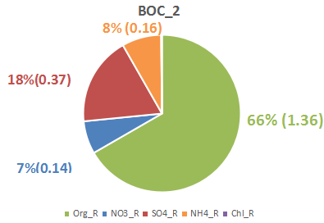
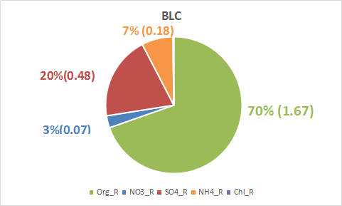
08/19 Cloudy
Three periods:
1. from 12:25-13:00 in Bottom Cloud (BOC_1);
2. from 14:55-15:25 in Bottom Cloud (BOC_2);
3. from 15:30-18:15 below cloud (BLC)

Slide 2
Mass Spectra

Slide 3
SMPS size distribution

