Slide 1
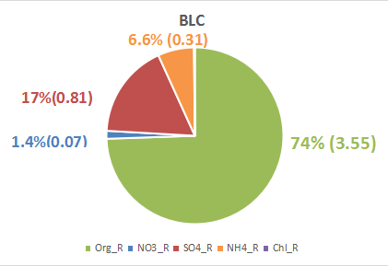
08/18 Cloudy (Quickly lifting)
Only one period:
1: 13:30-18:00 below cloud (BLC)

Slide 2
Mass Spectra

Slide 3
SMPS size distribution

